Slide 1
The Foundation

Slide 2
Simplify
Wolfram Alpha
Solve
Prime Factor the Polynomial

Slide 3
Properties

Slide 4
A property allows us to use a general idea in specific situations.
For instance a property of fire is that it needs oxygen to burn.
We use this property when we blow on a struggling campfire or extinguish a frying pan fire with a cover.
Numbers and operations have properties too.

Slide 6
Where it’s appropriate use a property to justify the step.
Simplify
____________________________________
Wrote subtraction as adding an opposite.
____________________________________
The commutative property of addition.
The distributive property.
____________________________________
____________________________________
Added.
___________________________________
The commutative property of addition.
____________________________________
Wrote adding an opposite as subtraction.

Slide 7
The Foundation

Slide 8
The Commutative properties are about order.

Slide 9
The Associative properties are about grouping.

Slide 10
Describe which property is being used to transform the upper expression to the lower expression. Don’t simplify the expression.
The commutative property of addition.
The associative property of addition.
The commutative property of multiplication.
The commutative property of multiplication.
The associative property of multiplication.

Slide 11
Describe which property is being used to transform the upper expression to the lower expression. Don’t simplify the expression.
The commutative property of addition.
The commutative property of multiplication.
The associative property of addition.
The associative property of multiplication.

Slide 12
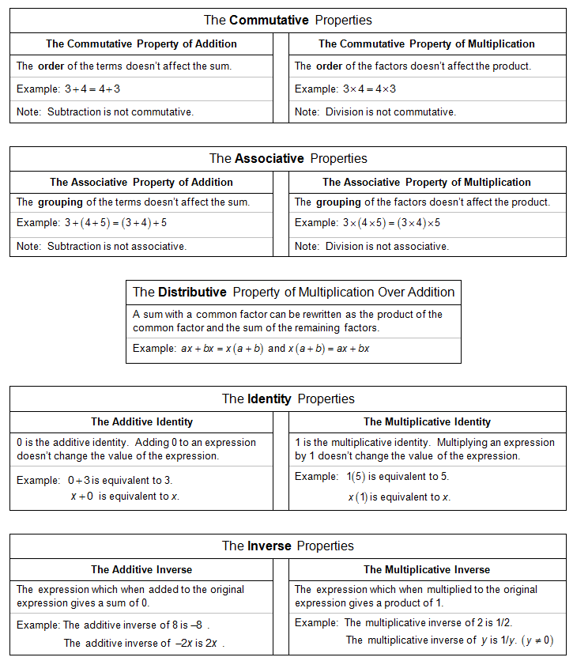

Slide 13
The Distributive property of multiplication over addition

Slide 14
Using the distributive property to add or subtract natural numbers
Simplify using the distributive property.

Slide 15
Use the distributive property to add or subtract like terms.

Slide 16
The Distributive property of multiplication over addition

Slide 17
Simplify using the distributive property

Slide 18
The Identity Properties

Slide 19
The Inverse properties

Slide 20
Describe which property is being used to transform the upper expression to the lower expression. Don’t simplify the expression.
The additive inverse.
The multiplicative identity.
The multiplicative inverse.
The multiplicative identity.

Slide 21
Describe which property is being used to transform the upper expression to the lower expression. Don’t simplify the expression.
The additive inverse. (4x + –4x + 7)
The additive identity.
The multiplicative identity.
The additive inverse.
The additive identity.
The additive inverse.

Slide 22
Fill in the property which allows each step.
____________________________________
The associative property of multiplication
____________________________________
The multiplicative inverse
____________________________________
The multiplicative identity

Slide 23
Fill in the property which allows each step.
____________________________________
The associative property of addition
____________________________________
The commutative property of addition
___________________________________
The associative property of addition
____________________________________
The additive inverse
The additive identity
____________________________________

Slide 24
Fill in the property which allows each step.
____________________________________
Wrote subtraction as adding an opposite
____________________________________
The commutative property of addition
The distributive property
____________________________________
____________________________________
Added
___________________________________
The commutative property of addition
____________________________________
Wrote adding an opposite as subtraction

Slide 25
Fill in the property which allows each step.
Additive property of equality
____________________________________
____________________________________
Added on the right side
____________________________________
Additive inverse
Additive identity
____________________________________
Multiplicative property of equality
____________________________________
The associative property of multiplication
____________________________________
The multiplicative inverse
____________________________________
The multiplicative identity
____________________________________

Slide 26
Justifying the Product to a Power Property
____________________________________
The definition of an exponent
____________________________________
The associative property of multiplication
___________________________________
The commutative property of multiplication
____________________________________
The associative property of multiplication
____________________________________
The definition of an exponent

Slide 27
Properties

