Slide 1
Linear Systems

Slide 2
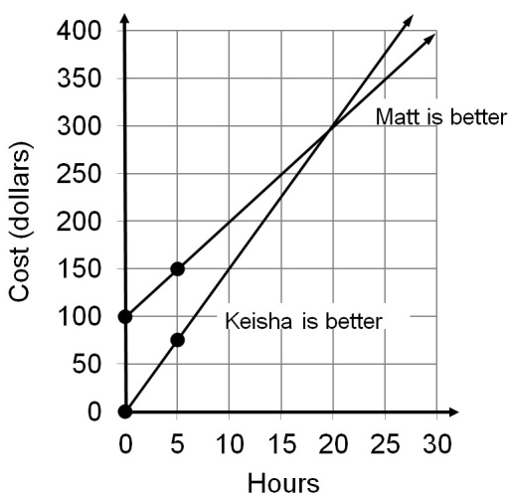
A linear system can be presented symbolically, as a graph, as a data table or in English.
A 2 x 2 linear system is a set containing two linear functions.

Slide 3
An ordered pair “solves” a system if the ordered pair makes both equations true.

Slide 4
Checking the solution of a system of linear equations

Slide 5
An ordered pair solves a system if the ordered pair makes both equations true.

Slide 7
“Solving” a system graphically

Slide 8
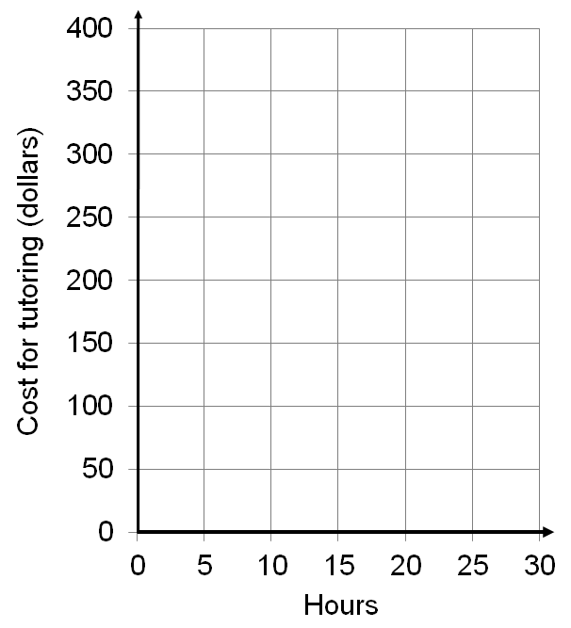
A student in a math class has decided to hire a tutor. One tutor, Matt, asks $100 for the semester and then charges $10 per hour. A second tutor, Keisha, charges a flat rate of $15 per hour. Which tutor is the “better buy”?

Slide 9
A student in a math class has decided to hire a tutor. One tutor, Matt, asks $100 for the semester and then charges $10 per hour. A second tutor, Keisha, charges a flat rate of $15 per hour. Which tutor is the “better buy”?
Matt is the better buy.
Keisha is the better buy.

Slide 10
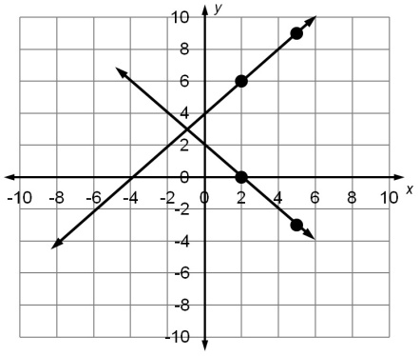
Graph each system to estimate the quadrant where the lines intersect and the point of intersection.

Slide 11
Graph each system to estimate the quadrant where the lines intersect and the point of intersection.

Slide 12
Graph each system to estimate the quadrant where the lines intersect and the point of intersection.

Slide 13
Graphing using the intercept method

Slide 14
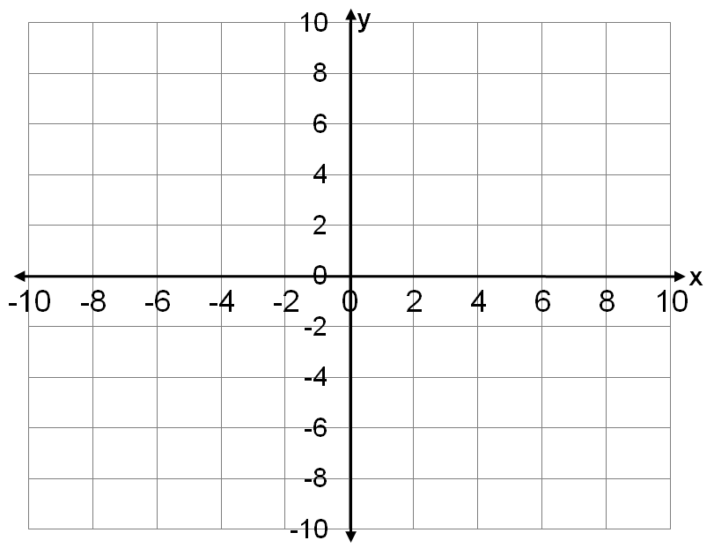
Graph using the intercept method.

Slide 15
Graph using the intercept method.

Slide 16
Graph using the intercept method.

Slide 17
Graph using the intercept method.

Slide 18
Graph each system to estimate the quadrant where the lines intersect and the point of intersection.

Slide 19
Applying Linear Systems

Slide 20
A student in a math class has decided to hire a tutor. One tutor, Matt, asks $100 for the semester and then charges $10 per hour. A second tutor, Keisha, charges a flat rate of $15 per hour. Which tutor is the “better buy”?

Slide 21
A student in a math class has decided to hire a tutor. One tutor, Matt, asks $100 for the semester and then charges $10 per hour. A second tutor, Keisha, charges a flat rate of $15 per hour. Which tutor is the “better buy”?

Slide 22
A student in a math class has decided to hire a tutor. One tutor, Matt, asks $100 for the semester and then charges $10 per hour. A second tutor, Keisha, charges a flat rate of $15 per hour. Which tutor is the “better buy”?
If you need 20 hours of tutoring or less go with Keisha. If you need more than 20 hours of tutoring go with Matt.

Slide 23
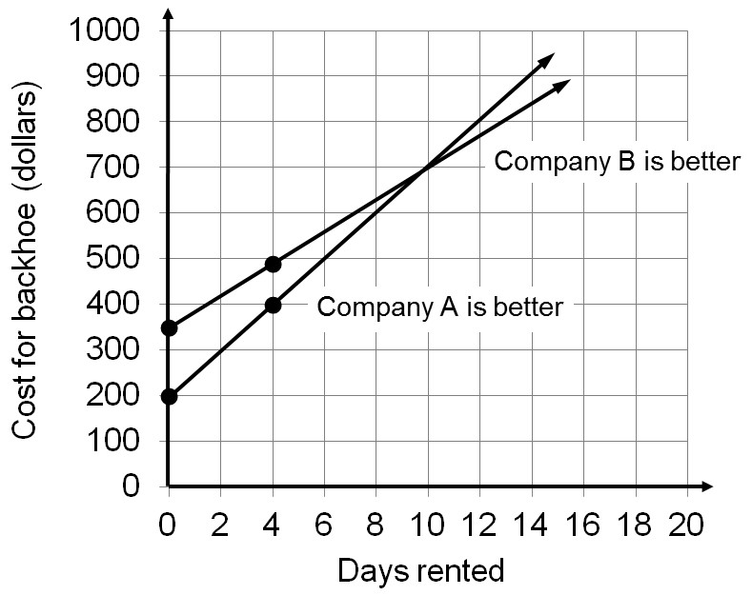
Company A charges $200 plus $50 a day to rent a backhoe, while Company B charges $350 plus $35 a day to rent the same type of backhoe. Which company is the better buy?
If you rent for 10 days or less go with Company A otherwise go with Company B.

Slide 24
A student can drive to school or take the bus. If they drive they estimate the cost is $3.50 per day for gas and $2.50 per day for parking. If they take the bus the cost is $30.00 a month for a bus card which allows them unlimited rides for $2.00 per day. If they want to save money, which is their best choice for the month?
If they go to school 7 days a month or less they should drive otherwise they should take the bus.

Slide 25
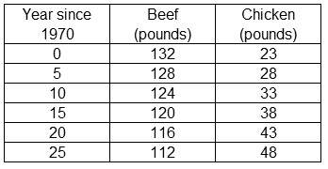
The data below shows meat consumption per person per year in the United States. The first column, year, is the independent item. The two columns that follow, beef and chicken, should both be considered a separate dependent item. Estimate the year chicken consumption will overtake beef consumption.

Slide 26
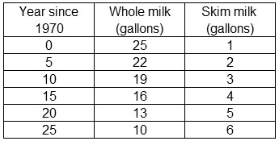
By 1970 people had been advised to change their diets to avoid certain diet related diseases. The data below shows milk consumption per person per year in the United States. Estimate the year skim milk consumption will overtake whole milk consumption.

Slide 27
Predict the year that high fructose corn syrup consumption will equal sugar consumption.
Year | Sugar | High fructose
since | consumption | corn syrup
1985 | (pounds) | (pounds)
5 | 63.5 | 50.0
10 | 63.5 | 57.6

Slide 28
In January 2010 CD sales were at 45,000 and began dropping by 800 per month.
In January 2010 MP3 sales began at 5,000 and began rising by 1,200 per month.
Build a linear function for both CD sales and MP3 sales using t for the number of months since January 2010 and S for the sales.
Use a linear system to find the year and month within that year that MP3 sales will overtake CD sales. Assume sales depends on the number of months since January 2010.

Slide 29
Some Special Cases

Slide 30
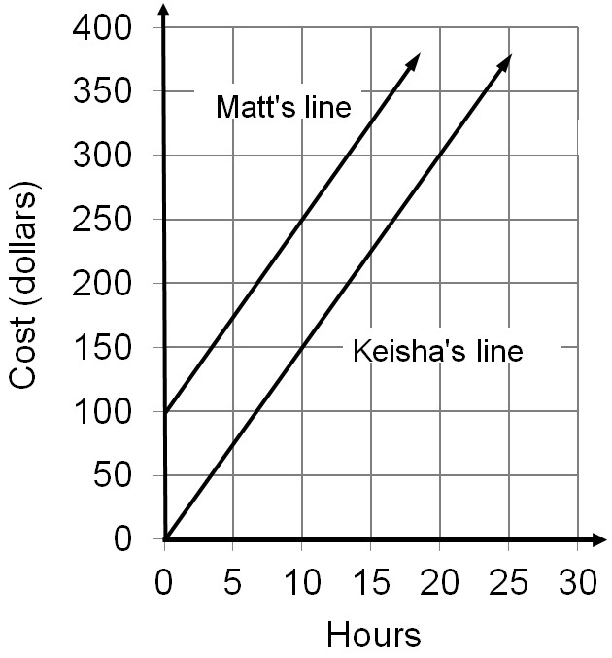
What if the system shares no common point.
Both Matt and Keisha charge $15 per hour and Matt still charges $100 for the semester.
The Lines are parallel ( have the same slope) but have different y-intercepts.
The system is inconsistent,
there is no solution.

Slide 31
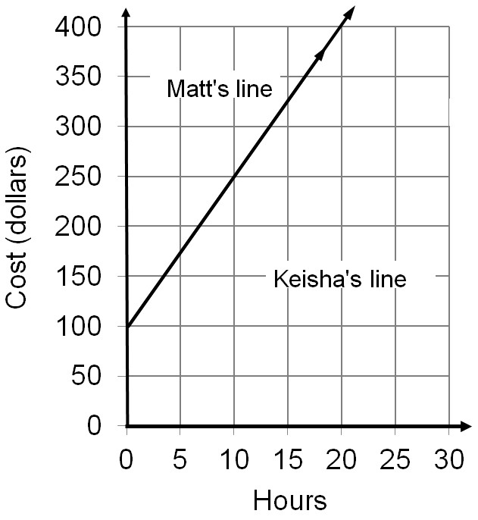
What if the system shares all points in common.
Both Matt and Keisha charge $100 per semester plus $15 per hour.
The lines are parallel and
have the same y-intercept.
The system is consistent
and dependent.

Slide 32
The vocabulary of solutions.
If the slopes are different the system is consistent (it has at least one solution) and independent (it has only one solution).
If the slopes are the same and the y-intercepts are the same the system is consistent (it has at least one solution) and dependent (the system has an infinite number of solutions).
If the slopes are the same and the y-intercepts are different the system is inconsistent (there is no solution).

Slide 33
Use the slope and y-intercept to decide if the system is inconsistent, consistent and dependent or consistent and independent. If the system is consistent find the solution(s).

