Slide 1
Linear Functions Getting Ready

Slide 2
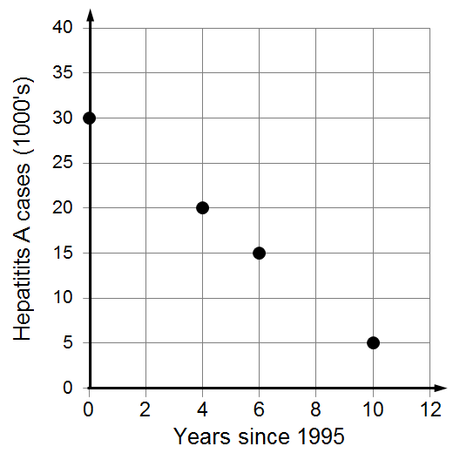
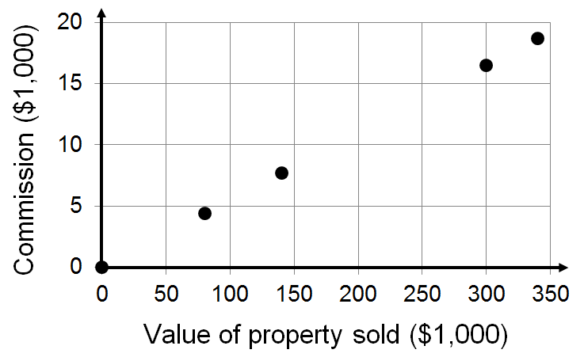
We often graph a data table to look for patterns. Graphs like these are good candidates for a linear function.

Slide 3
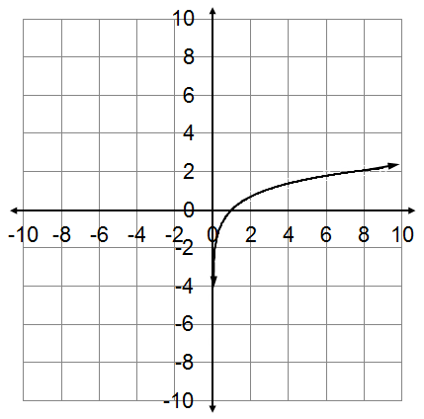
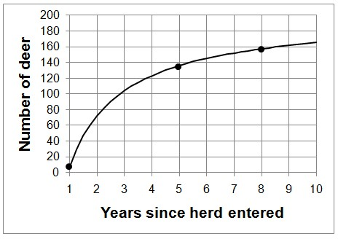
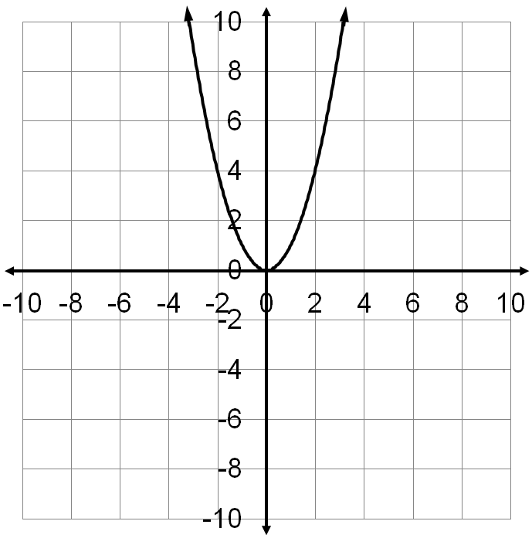
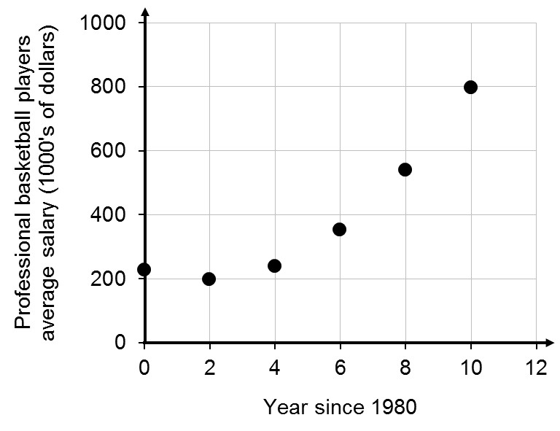
These graphs are not good candidates for a linear function because the data does not look like a straight line.

Slide 4
Two important ideas for any function are 1. Intercepts 2. (Average rate of change) Slope
One nice thing about linear functions is that knowing the slope and y-intercept allows us to build the unique linear function.

Slide 5
Any linear function can be written in the form;
y = mx + b
Slope
(rate of change)
y-intercept
We can build the linear function quickly from two ordered pairs. We use the ordered pairs to find m, the slope, and b, the y-intercept.

Slide 6
Types of Slope

Slide 7
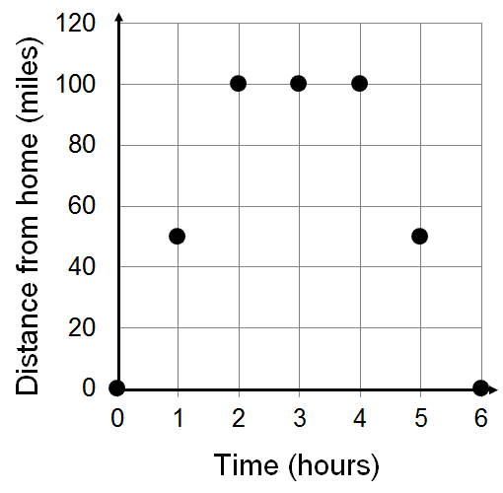
Recall that we use intervals on x to describe where the function is increasing, decreasing or constant.
Constant
Increasing
Decreasing
The function is increasing on the interval x = 0 to x = 2.
The function is constant on the interval x = 2 to x = 4.
The function is decreasing on the interval x = 4 to x = 6.

Slide 8
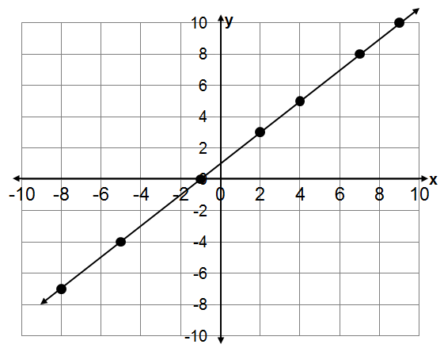
Increasing function
Positive Slope
The values of y increase
As the values of x increase

Slide 9
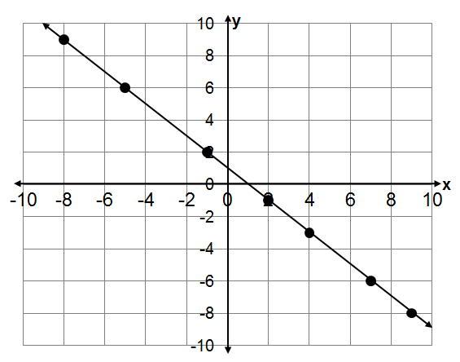
Decreasing function
Negative Slope
As the values of x increase
The values of y decrease

Slide 10
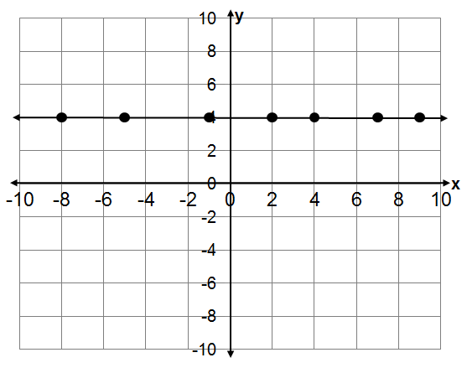
Constant Function
Zero Slope
The values of y stay the same
As the values of x increase

Slide 11
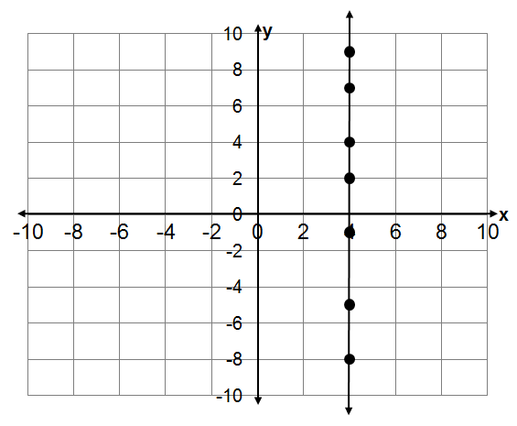
Undefined Slope
Not a Function

Slide 12
Review Slope

Slide 13
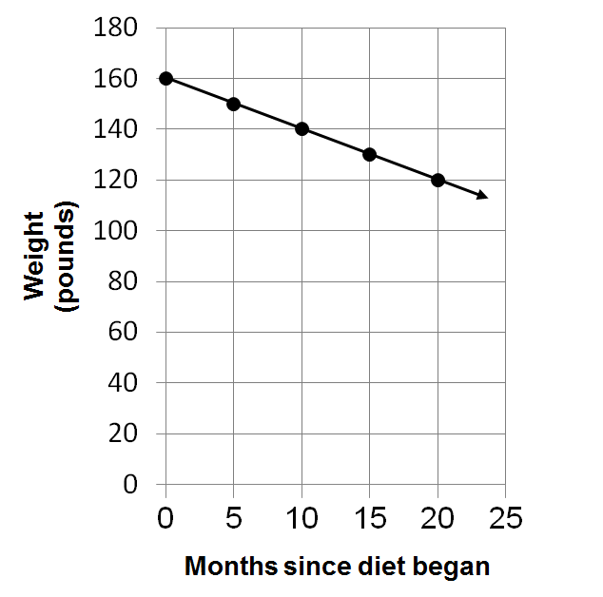
Find the slope as the function goes from x = 10 to x =20.
When x =10, y =140
When x =20, y =120

Slide 14
Find the slope

Slide 15
Review y-intercept

Slide 16
Recall that the y-intercept of a function is the ordered pair when x is 0, (0,b) but that people often refer to just the y-coordinate of the y-intercept.

Slide 17
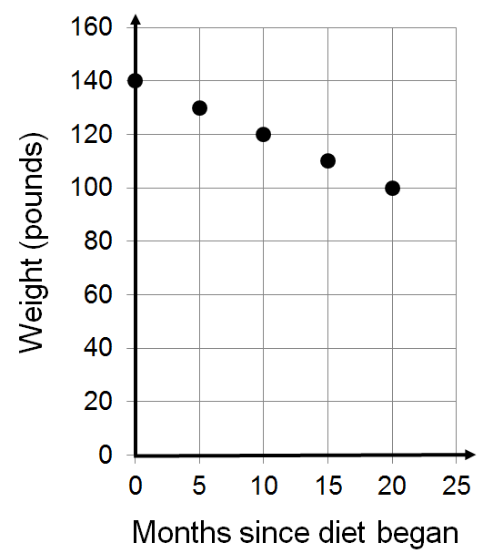
What’s the y-intercept?

Slide 18
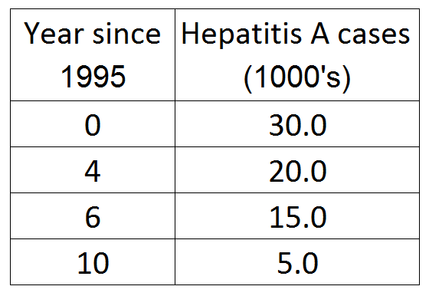
What’s the y-intercept?

Slide 19
Linear Functions Getting Ready

Slide 20
Slope-Intercept Form for the Equation of a Line

Slide 21
y = mx + b
Slope
(Average rate of change)
y-intercept

Slide 22
Find the equation of the line in slope-intercept form.
Always start with y = mx + b.
Find the value of m.
Find the value of b
Try to find b visually.
Use algebra if you can’t find b visually.
Rewrite y = mx + b with constants for m and b.

Slide 23
Finding b visually

Slide 24
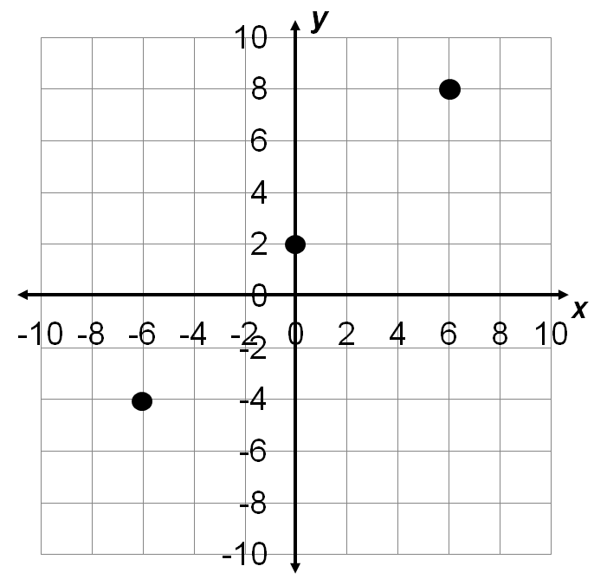
Using the given information, build the equation of the line in slope-intercept form.
The y-intercept is (0,2).

Slide 25
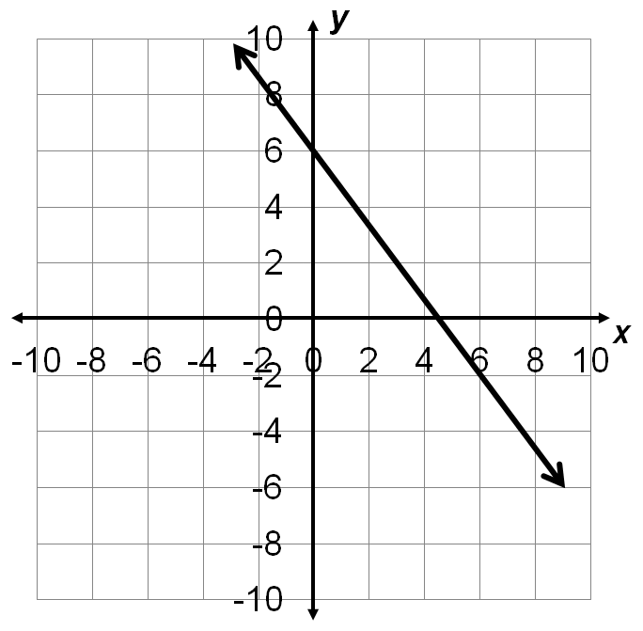
Using the given information, build the equation of the line in slope-intercept form.
The y-intercept is (0,6).

Slide 26
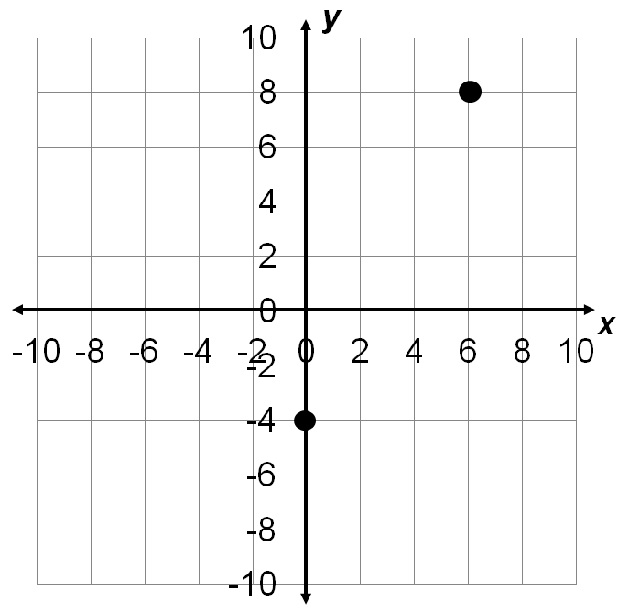
Using the given information, build the equation of the line in slope-intercept form.

Slide 27
Using the given information, build the equation of the line in slope-intercept form.

Slide 28
Using the given information, build the equation of the line in slope-intercept form.

Slide 29
Slope-Intercept Form for the Equation of a Line

Slide 30
Using Graphs to Apply Slope-Intercept Form When b is Given

Slide 31
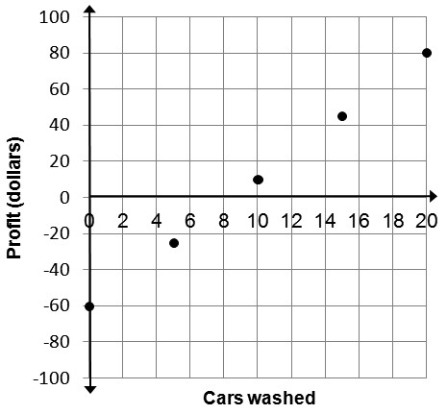
What is the general meaning of the slope?
How the profit changes as the number of cars washed changes.
Discuss the specific meaning of the slope.
Profit increases $7 for every car that’s washed.
Discuss the specific meaning of the y-intercept.
Their initial profit was -$60.
Build the linear function.
y = 7x – 60

Slide 32
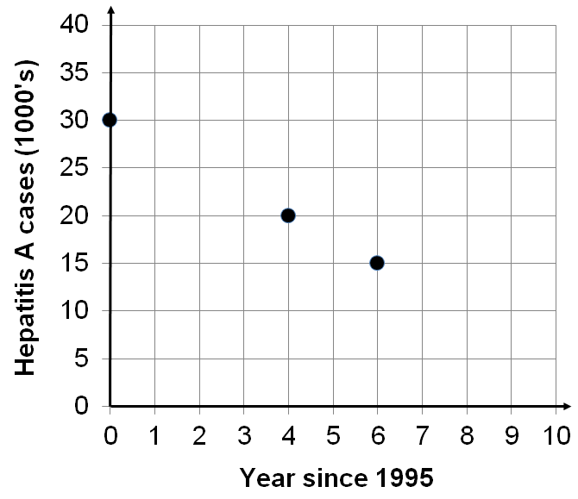
What is the general meaning of the slope?
How cases of Hepatitis A are changing over time.
Discuss the specific meaning of the slope.
The cases of Hepatitis A are decreasing by 2,500 per year.
Discuss the specific meaning of the y-intercept.
There were 30,000 cases of Hepatitis A in 1995.
Build the linear function.
y = – 2.5x +30

Slide 33
Discuss the specific meaning of the slope.
The cases of Hepatitis A are decreasing by 2,500 per year.
Discuss the specific meaning of the y-intercept.
There were 30,000 cases of Hepatitis A in 1995.
Build the linear function.
y = – 2.5x +30

Slide 34
Using Graphs to Apply Slope-Intercept Form When b is Given

Slide 35
Year since | Uncompensated
2005 | care (millions)
0 | 52.6
2 | 69
3 | 77.2
c) Build the linear function.
d) Use the function to estimate the cost of uncompensated care in 2020.
a) What’s the specific meaning of the slope?
e) Estimate the first year the cost will exceed 200 million.
b) What’s the specific meaning of the y-intercept?

Slide 36
Applying Slope-Intercept Form b is Given

Slide 37
Using algebra to find the y-intercept

Slide 38
Find the equation of the line in slope-intercept form.
Always start with y = mx + b.
Find a value for m.
Substitute values for m, y and x and solve for b.
Rewrite y = mx + b with values for m and b.

Slide 39
Find the equation of the line in slope-intercept form.
Always start with y = mx + b.
Substitute a value for m.
Substitute values for y and x. Solve for b.
Rewrite y = mx + b with values for m and b.

Slide 40
Find the equation of the line in slope-intercept form.
Always start with y = mx + b.
Substitute a value for m.
Substitute values for y and x. Solve for b.
Rewrite y = mx + b with values for m and b.

Slide 41
Find the equation of the line in slope-intercept form.
Always start with y = mx + b.
Substitute a value for m.
Substitute values for y and x. Solve for b.
Rewrite y = mx + b with values for m and b.

Slide 42
Find the equation of the line in slope-intercept form.
Always start with y = mx + b.
Substitute a value for m.
Substitute values for y and x. Solve for b.
Rewrite y = mx + b with values for m and b.

Slide 43
Find the equation of the line in slope-intercept form.
Always start with y = mx + b.
Substitute a value for m.
Substitute values for y and x. Solve for b.
Rewrite y = mx + b with values for m and b.

Slide 44
Find the equation of the line in slope-intercept form.
Always start with y = mx + b.
Substitute a value for m.
Substitute values for y and x. Solve for b.
Rewrite y = mx + b with values for m and b.

Slide 45
Using algebra to find the y-intercept

Slide 46
Applying Slope-Intercept Form b is Found Algebraically

Slide 47
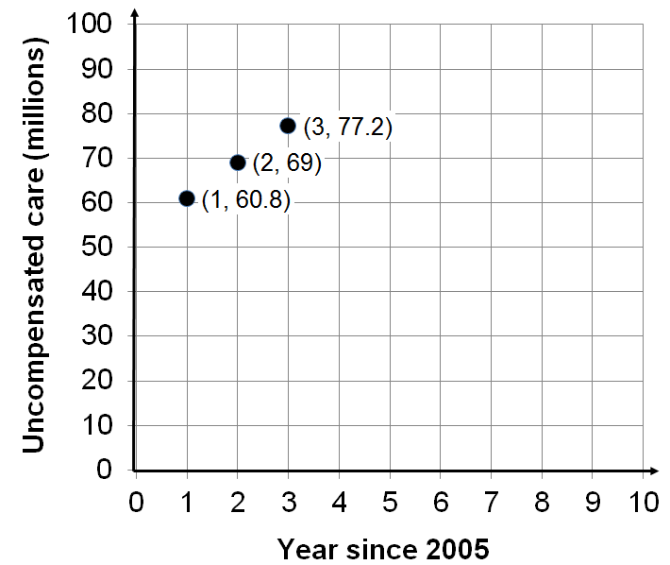
c) Build the linear function.
d) Use the function to estimate the cost of uncompensated care in 2014.
a) What’s the specific meaning of the slope?
e) Estimate the first year the cost will exceed 150 million.
b) What’s the specific meaning of the y-intercept?

Slide 48
After a number of trips a driver records the following data.
c) Build the linear function.
Gallons used | Miles driven
32 | 800
7 | 175
18 | 450
d) Estimate the gallons needed to drive 1,250 miles.
a) What’s the specific meaning of the slope?
e) Estimate how far you can drive on 40 gallons.
b) What’s the specific meaning of the y-intercept?

Slide 49
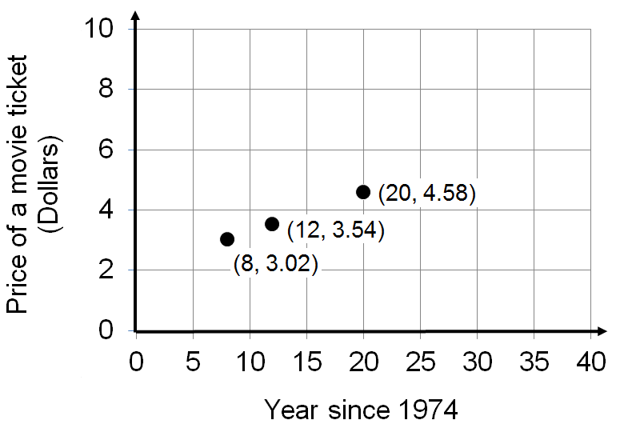
c) Build the linear function.
d) Estimate the price of a movie ticket this year.
a) What’s the specific meaning of the slope?
e) Estimate the year the average price will rise to $8.00.
b) What’s the specific meaning of the y-intercept?

Slide 50
c) Build the linear function.
d) Estimate the year the number of fires will drop to 400,000.
a) What’s the specific meaning of the slope?
e) Estimate the number of fires in 2002.
b) What’s the specific meaning of the y-intercept?

Slide 51
Applying Slope-Intercept Form b is Found Algebraically

Slide 52
Given the equation y = – 2x + 80
Explain the meaning of the linear equation if;
x is the minutes spent gambling and y is the money remaining in dollars.
y is the level of a pond in inches and x is the number of days without rain.
x is the minutes since a talk began and y is the people remaining in the room.
y is the initial cost in dollars and x is the number of people who have played a carnival game.

