Slide 1
Intercepts
An Introduction

Slide 2
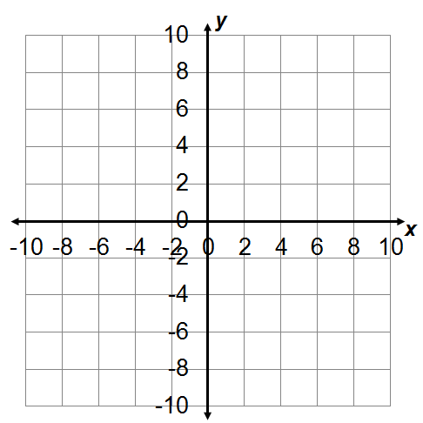
The y-intercept of a function is the ordered pair when x is 0.
An x-intercept of a function is any ordered pair when y is 0.
Although the x-intercept and the y-intercept are ordered pairs, in practice people often refer to just the x-coordinate of the x intercept or just the y-coordinate of the y-intercept.

Slide 3
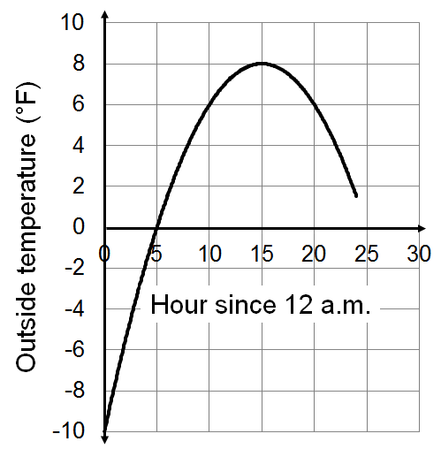

Slide 4
Time traveling in car (hours) | Distance from home (miles)
0 | 288
2.25 | 172
4.5 | 81
6 | 0
0
288
6
0

Slide 5
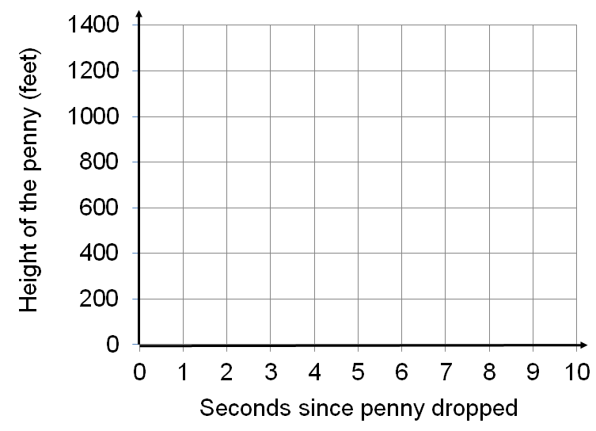
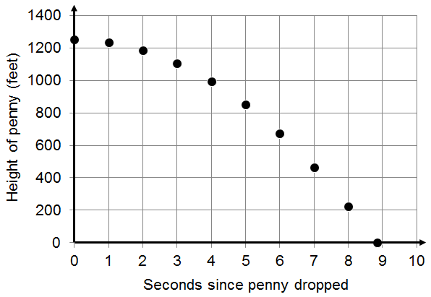
What is the general meaning of the y-intercept?
What is the specific meaning of the y-intercept?
What is the general meaning of any x-intercept?
What is the specific meaning of any x-intercepts?

Slide 6
Intercepts
An Introduction

Slide 7
Applying Intercepts
Graphs and Tables

Slide 8
What is the general meaning of the y-intercept?
What is the specific meaning of the y-intercept?
What is the general meaning of any x-intercept?
What is the specific meaning of any x-intercepts?

Slide 9
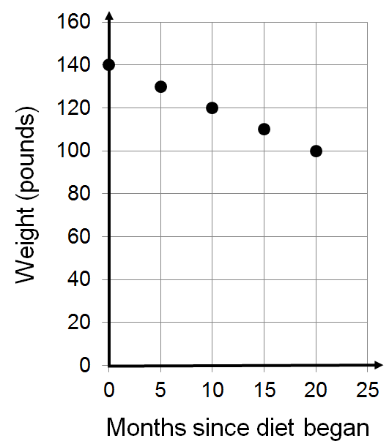
What is the general meaning of the y-intercept?
What is the specific meaning of the y-intercept?
What is the general meaning of any x-intercept?
Why won’t there be any x-intercepts?

Slide 10
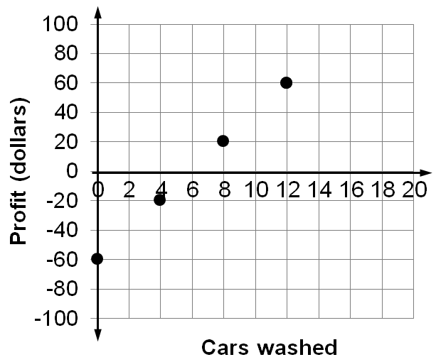
What is the general meaning of the y-intercept?
What is the specific meaning of the y-intercept?
What is the general meaning of any x-intercept?
What is the specific meaning of each x-intercept?

Slide 11
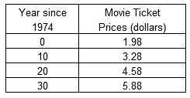
What is the general meaning of the y-intercept?
What is the specific meaning of the y-intercept?
What is the general meaning of any x-intercept?
Why won’t there be any x-intercepts?

Slide 12
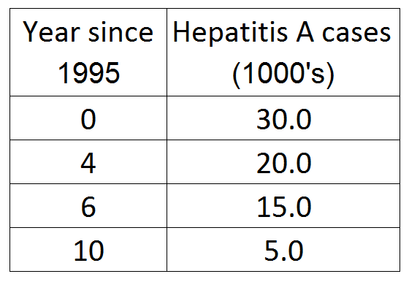
What is the general meaning of the y-intercept?
What is the specific meaning of the y-intercept?
What is the general meaning of any x-intercept?
What is the specific meaning of each x-intercept?

Slide 13
Applying Intercepts
Graphs and Tables

Slide 14
Graph the data and extend the line to estimate the intercepts. Use 0 to 20 for x values and 0 to 1000 for y values. Discuss the meaning of any intercept or explain why the intercept doesn’t exist.

Slide 15
Graph the data and extend the line to estimate the intercepts. Use 0 to 20 for x values and 0 to 100 for y values. Discuss the meaning of any intercept or explain why the intercept doesn’t exist.

Slide 16
Graph the data and extend the line to estimate the intercepts. Discuss the meaning of any intercept or explain why the intercept doesn’t exist.
A grade school is putting on a carnival. When people enter they buy tokens which they use to play the carnival games. Scale the x-axis from 0 to 2000 and the y-axis from -400 to 400.

Slide 17
Graph the data and extend the line to estimate the intercepts. Discuss the meaning of any intercept or explain why the intercept doesn’t exist. Scale the x-axis from 0 to 80 and the y-axis from 0 to 80.

Slide 18
Applying Intercepts
Equations
Part 1

Slide 19
To find the y-intercept of an equation substitute 0 for x and solve for y.
To find the x-intercept(s) of an equation substitute 0 for y and solve for x.
Before any cars are washed the loss is $20.
To make up the $20 loss (your profit is $0) you need to wash 4 cars.

Slide 20
What is the general meaning of the y-intercept?
What is the specific meaning of the y-intercept?
What is the general meaning of any x-intercept?
Why won’t there be any x-intercepts?
In 1960 around 13% of households were one-person households.

Slide 21
What is the general meaning of the y-intercept?
What is the specific meaning of the y-intercept?
What is the general meaning of any x-intercepts?
What is the specific meaning of the x-intercepts?
Setting the income to $0 leads to a price of $0 or $8.
Setting the price to $0 leads to an income of $0.

Slide 22
Applying Intercepts
Equations
Part 1

Slide 23
Applying Intercepts
Equations
Part 2

Slide 24
y
What is the general meaning of the y-intercept?
What is the specific meaning of the y-intercept?
What is the general meaning of any x-intercepts?
What is the specific meaning of the x-intercepts?
The value doesn’t go to $0.
The car initially cost $31,500.

Slide 25
x
y
What is the general meaning of the y-intercept?
What is the specific meaning of the y-intercept?
What is the general meaning of any x-intercepts?
What is the specific meaning of the x-intercepts?
The pounds of beef consumed will not drop to 0.
In 1985 approximately 79 pounds of beef was consumed per person.

Slide 26
Applying Intercepts
Equations
Part 2

