Slide 1
Functions

Slide 2
The Basic Graphs

Slide 3
What will be the cost of one year of community college in 2016?
Idea
Gather data on past costs.
Make a picture of the data to look for a pattern.
If a pattern exists, describe the pattern using numbers, operations, grouping and variables.
Predict the past or future using the result of step 3.

Slide 4
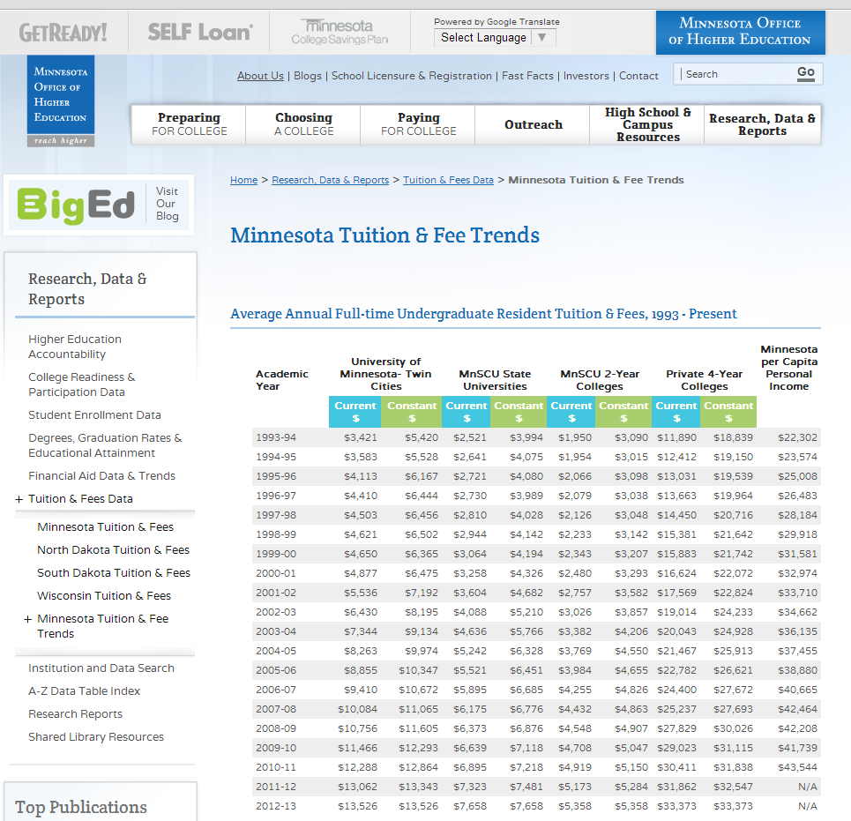
Step 1. Gather data

Slide 5
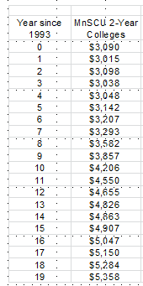

Step 1. Gather data

Slide 6
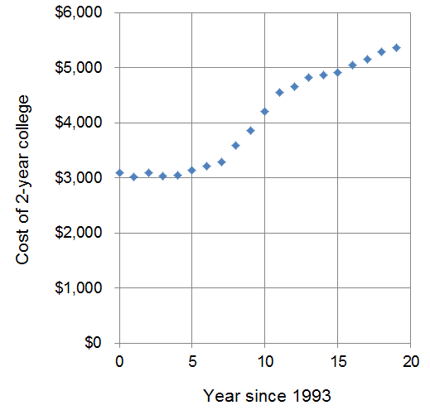
Step 2. Graph the data

Slide 7
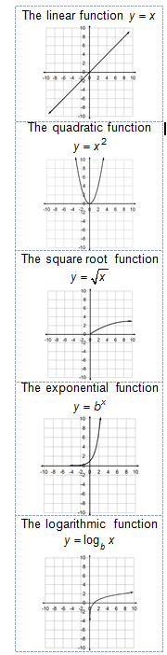
Step 2. Look for patterns

Slide 8
Step 2. Graph the data

Slide 9
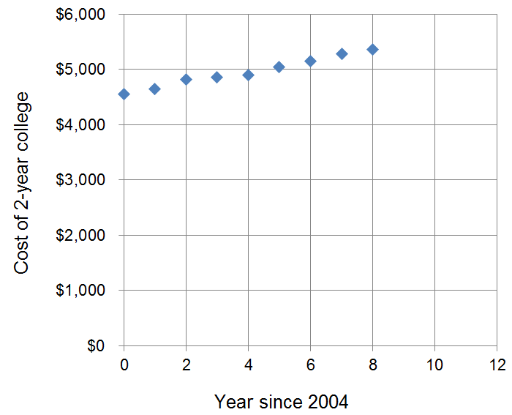
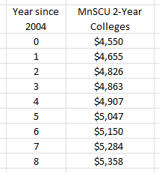
Step 2. Graph the data

Slide 10
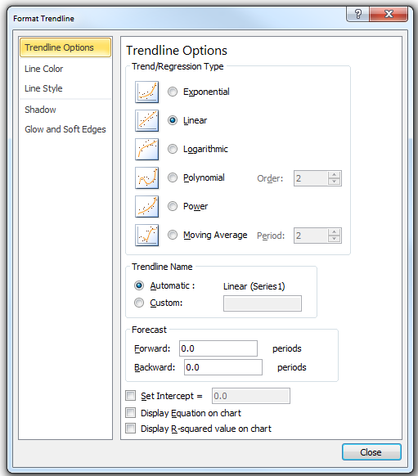
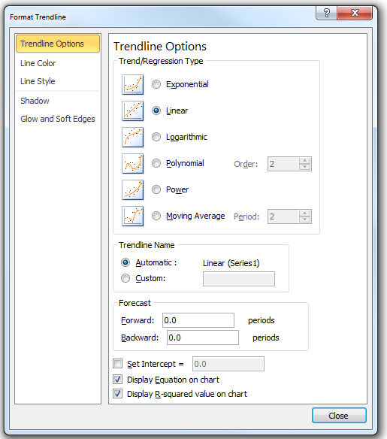
Step 2. Look for patterns

Slide 11
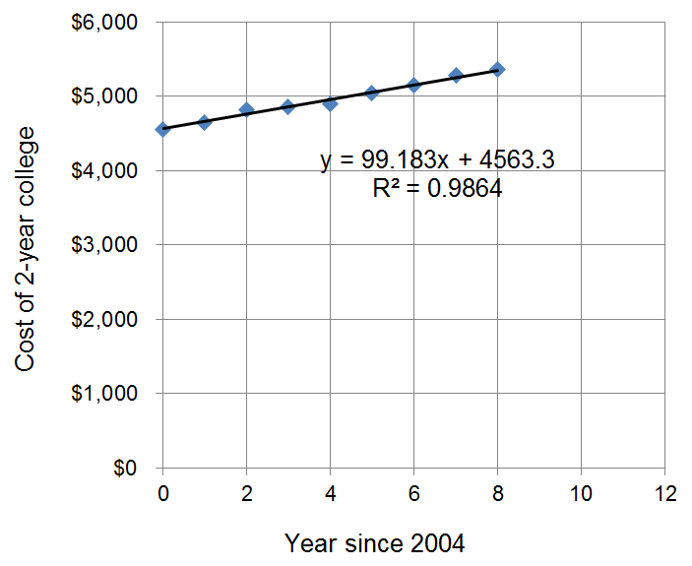
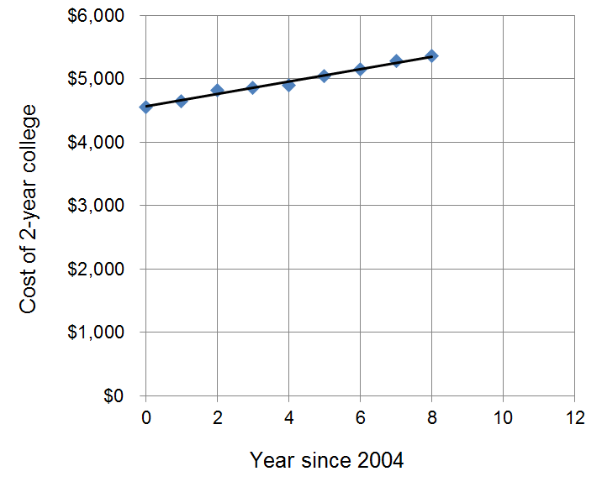
Step 3. Model using algebra

Slide 12
Step 4. Predict the future
What’s the cost in 2016?
Around $5,800
What’s the cost in 2016?

Slide 13
Step 4. Predict the past
What was the first year the cost was $5,000?
Around 2008
What was the first year the cost was $5,000?
Around 2008

Slide 14
In a function every “x” value has only one “y” value.
Notice every year has only one cost.
Fails
The Vertical Line Test

Slide 15
I’d like to use the year to predict the cost of college.
Written
Equation
Data Table
Graph

Slide 16
Domain and Range

Slide 17
A function in two variables assigns each element from a “domain” set to a specific element in a “range” set.
Domain
Range
0
3
4
8
40
48
50
54

Slide 18
A function in two variables assigns each element from a “domain” set to a specific element in a “range” set.
Domain
Independent variable
Input
Explanatory variable
Manipulated variable
Controlled variable
Range
Dependent variable
Output
Response variable
Response variable
Measured variable

Slide 19
A function in two variables assigns each element from a “domain” set to a specific element in a “range” set.
Year since 2005
Deer in the park
Domain
Range
0
3
4
8
40
48
50
54

Slide 20
A function in two variables assigns each element from a “domain” set to a specific element in a “range” set.
Year since 2005
Deer in the park
0
3
4
8
40
48
50
54
Not a function

Slide 21
A function in two variables assigns each element from a “domain” set to a specific element in a “range” set.
Days without rain
Pond level (inches)
0
3
4
8
40
48
50
54

Slide 22
Domain and Range
I’d like to predict the cost of college given the year.
Domain
Range
Range
Domain
Graph
Range
Domain

Slide 23
Domain and Range
I’d like to predict the cost of college given the year.
Domain
Range
Range
Domain
Range
Domain

Slide 24
Domain and Range

Slide 25
Describing a data table

Slide 26
Describing a data table
I’d like to predict the cost of college given the year.
Graph

Slide 27
A Data Table
Columns
Domain description | Range description
Domain element 1 | Range element 1
Domain element 2 | Range element 2
Domain element 3 | Range element 3
Rows

Slide 28
In ordered pairs domain values are usually on the left and range values are usually on the right.
(Domain element 1, Range element 1)
(Domain element 2, Range element 2)
(Domain element 3, Range element 3)

Slide 29
Domain
Range

Slide 30
Year since | U.S. T.V. sets
1949 | (millions)
0 | 1.5
1 | 4
3 | 19
11 | 46
21 | 60
29 | 73
51 | 102
55 | 110
60 | 115
61 | 116
Describe the domain and the range.
Estimate the number of TV's in 1980.
Estimate the first year there were 112,000,000 TV's.
Try to use the increase in TV sets between 1960 and 1970 to estimate the increase in sets per year between 1960 and 1970.

Slide 31
Year since | Number of pieces
2003 | of malware
0 | 1,288,738
1 | 1,431,140
2 | 1,764,947
3 | 2,787,844
4 | 8,705,343
5 | 17,084,275
6 | 29,481,109
7 | 49,295,341
Describe the domain and the range.
Estimate the first year there was twice as many pieces of malware as there was in 2004.
How many pieces of malware was there in 2008?
Compare the increase in malware between 2005-2006 to the increase between 2009-2010.

Slide 32
Year since | Chickenpox
1982 | cases (1000's)
0 | 168.8
1 | 175.4
3 | 183.2
4 | 184.4
6 | 181.4
7 | 177.2
8 | 171.2
9 | 163.4
10 | 153.8
11 | 142.4
12 | 129.2
13 | 114.2
14 | 97.4
15 | 78.8
Describe the domain and the range.
Estimate the number of cases in 2004.
When did the number of cases first return to the 1982 level?
What year did the number of cases peak and how many cases were there that year?

Slide 33
Describing a data table

Slide 34
Graphing a data table

Slide 35
Graphing a data table
I’d like to predict the cost of college given the year.
Graph

Slide 36
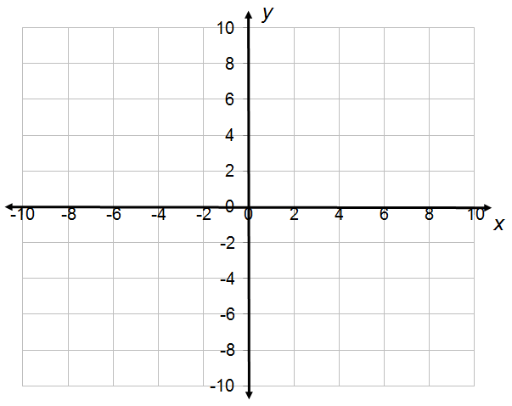
There are four quadrants

Slide 37
We number them counterclockwise

Slide 38
Using numbers one through four
2
1
3
4

Slide 39
Sometimes “Roman” Numerals are used
II
I
III
IV

Slide 40
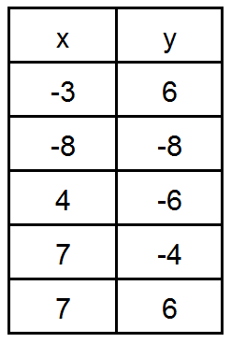
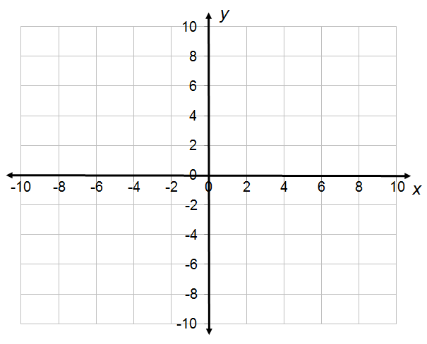
Graph the data table.

Slide 41
,
Graph the data table.

Slide 42
,
Graph the data table.

Slide 43
Graph the data table.
Not a function
Fails
The Vertical Line Test

Slide 44
Graph the data table. After graphing, use the vertical line test to decide if you have the graph of a function.
x | y
-4 | 3
0 | -2
8 | -2
-8 | -3
3 | 0

Slide 45
Graph the data table. After graphing, use the vertical line test to decide if you have the graph of a function.
x | y
-3 | -9
2 | -5
0 | 1
2 | 3
6 | -5
Not a function

Slide 46
The Basic Graphs

Slide 47
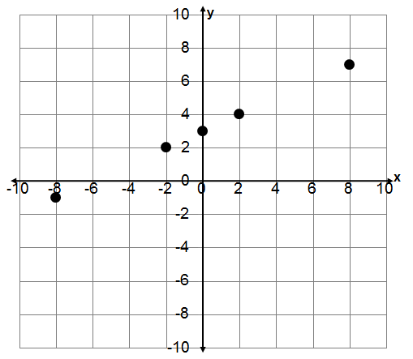
Predict the shape of the graph using the operations in the function and the five basic shapes. Then graph the function and see if the shape is the same as you predicted. Make sure you label the axes.
x | y
–8 | -1
–2 | 2
0 | 3
2 | 4
8 | 7

Slide 48
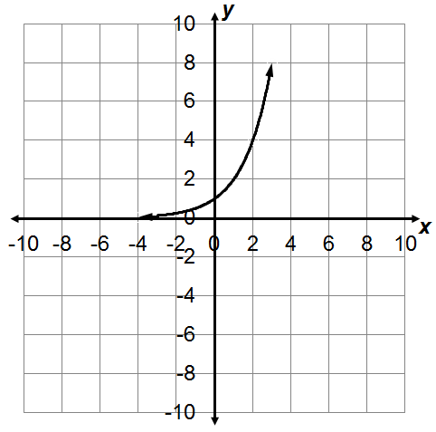
Predict the shape of the graph using the operations in the function and the five basic shapes. Then graph the function and see if the shape is the same as you predicted. Make sure you label the axes.
x | y
–4 | 0.0625
–1 | 0.5
0 | 1
2 | 4
3 | 8

Slide 49
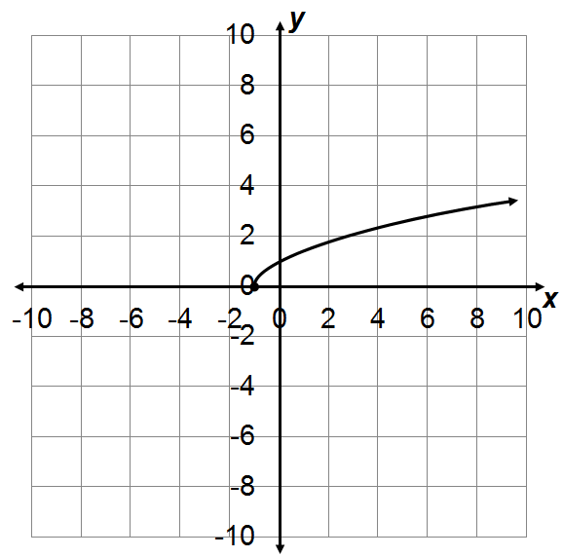
Predict the shape of the graph using the operations in the function and the five basic shapes. Then graph the function and see if the shape is the same as you predicted. Make sure you label the axes.
x | y
–1 | 0
0 | 1
3 | 2
6 | 2.6
8 | 3

Slide 50
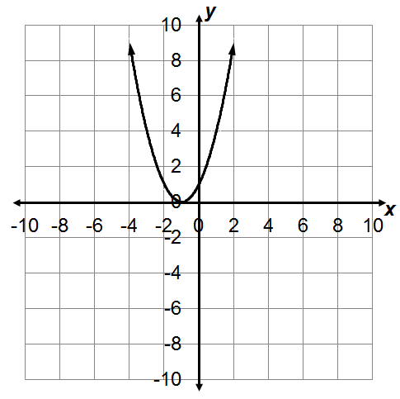
Predict the shape of the graph using the operations in the function and the five basic shapes. Then graph the function and see if the shape is the same as you predicted. Make sure you label the axes.
x | y
-4 | 9
-2 | 1
0 | 1
1 | 4
2 | 9

Slide 51
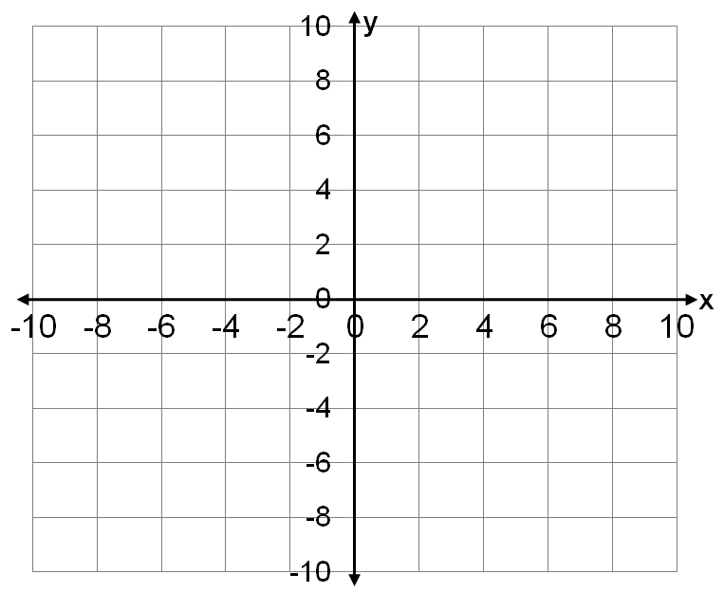
On a graph, the domain description and the domain elements are on the horizontal axis.
Domain

Slide 52
On a graph, the range description and the range elements are on the vertical axis.
Range

Slide 53

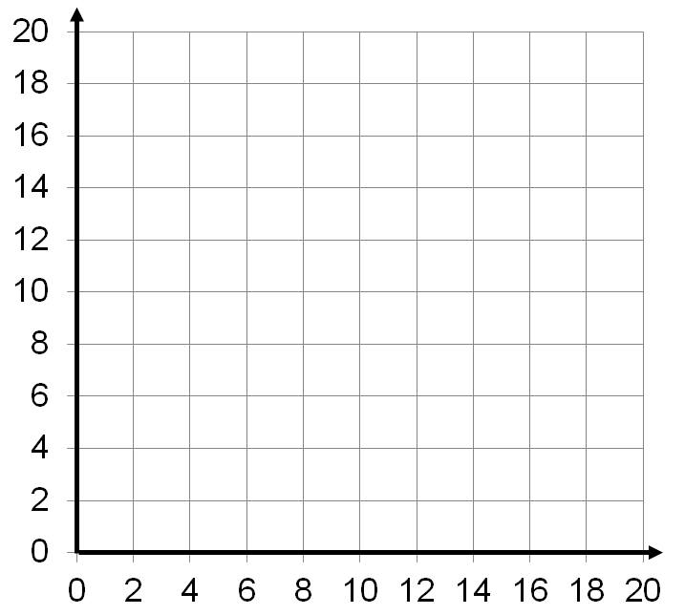

Scale the x-axis from 0 to 20 and the y-axis from 0 to 20. Label the axes and graph the data.
Use your graph to estimate whole milk consumption in 2000.
Use your graph to estimate the first year consumption will reach 9 gallons.
Use your graph to estimate when milk will drop 4 gallons lower than 1985 levels.

Slide 54
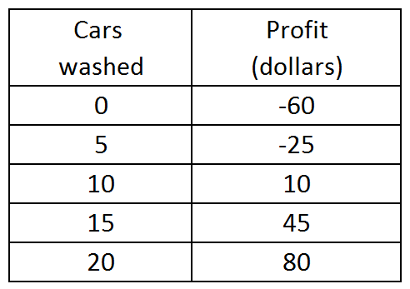
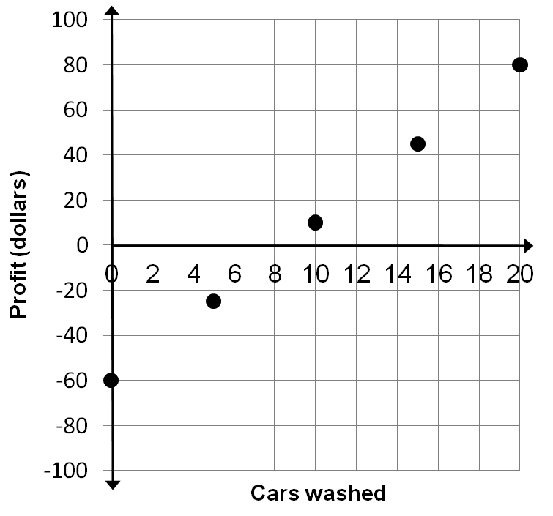
Scale the x-axis from 0 to 20 and the y-axis from
-100 to 100. Label the axes and graph the data.
Use your graph to estimate the profit if 18 cars are washed.
Can you use the change in profit that occurs between washing 10 cars and 15 cars to estimate the profit for 1 car?
Use your graph to estimate when the car wash will “break even”.

Slide 55
Year since 1954 | Cases of nonparalytic polio (100’s)
0 | 181
2 | 81
4 | 37
6 | 16
Graph the function. Scale the x-axis from 0 to 10 and the y-axis from 0 to 200. Label your axes.
Use your graph to estimate the number of polio cases in 1955.
Use your graph to estimate the year there were 3,000 cases.
Use your graph to estimate when the number of cases will fall to 2,000 less than in 1956.

Slide 56
Year since 1960 | U.S. Population (Millions)
0 | 178
20 | 230
40 | 282
50 | 307
Graph the function. Scale the x-axis from 0 to 80 and the y-axis from 0 to 400. Label your axes.
Predict the U.S. population in 1970.
What year do you predict the U.S. population will reach 400 million.
Predict the U.S. population this year.

Slide 57
Graphing a data table

Slide 58
Describing a Data Table Algebraically

Slide 59
Describing a data table algebraically
I’d like to predict the cost of college given the year.
Graph

Slide 60
The Basic Graphs

Slide 61
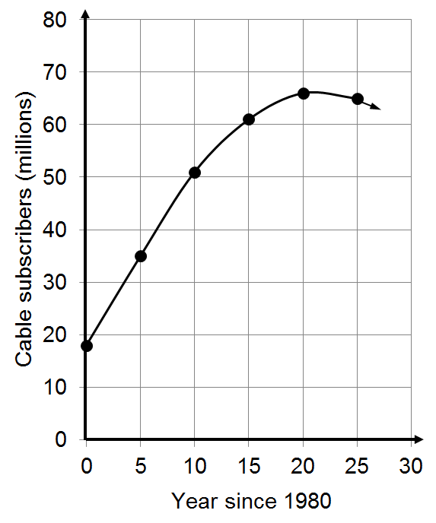
This graph can be approximated using the quadratic function;
To predicted the number of subscribers (in millions) in 2001 (the peak year).
Substitute 21 for x and solve for y.
In 2001 there were about 63.2 million subscribers.

Slide 62
This graph can be approximated using the quadratic function;
Use the graph to predict the first year there were 50 million subscribers.
Continue the curve and predict when the number of subscribers will return to 50 million.
To predict the year the number of subscribers will return to 50 million. Substitute 50 for y and solve for x
There will be 50 million subscribers in 1990 and again in 2013

Slide 63
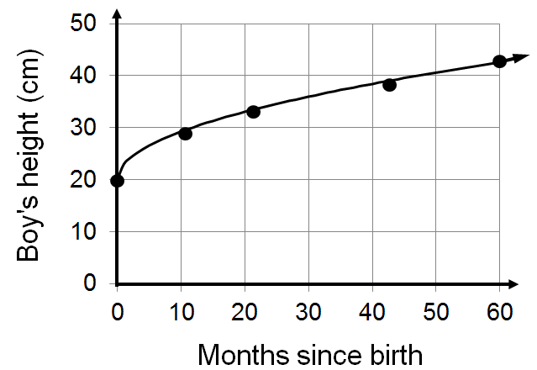
This graph can be approximated using the square root function;
a. Predict the height of a boy that is 35 months old by replacing x with 35.
b. Replace y with 40 to find the approximate age of a boy (in months) that is 40 cm tall.

Slide 64
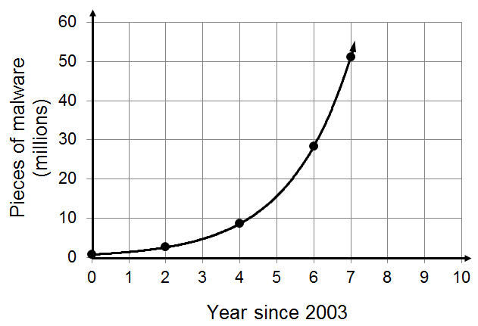
This graph can be approximated using the exponential function;
a. Replace x with 12 to predict the pieces of malware in 2015.
b. Replace y with 100 to predict the first year that the number of pieces of malware will reach one hundred million.

Slide 65
Describing a Data Table Algebraically

