Slide 1
Functional Notation

Slide 2
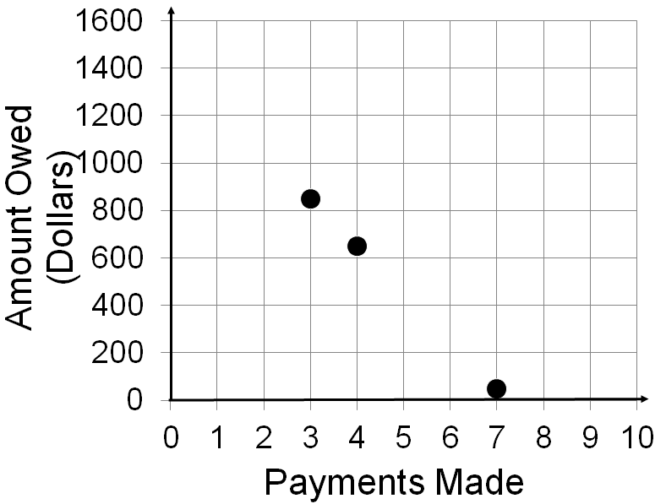
Written
Number of payments | Amount owed (Dollars)
3 | 850
4 | 650
7 | 50
Equation
Data Table
Graph

Slide 3
Functional notation allows us to discuss functions without the vagueness of English.
The average height in centimeters of a child in the United States can be estimated by adding fifty to the product of the child’s age and six and a half.

Slide 4
Procedure –Building a Two Item Function Using Functional Notation
a) Decide on the two items. Choose a variable to represent the values of each.
b) Decide which variable will represent the domain values and which will represent the range values.
c) On the left side of the equation write the dependent variable outside parentheses and the independent variable inside parentheses.
d) On the right side use operations to show how to find the range value associated with each domain value.

Slide 5
The average height in centimeters of a child in the United States can be estimated by adding fifty to the product of the child’s age and six and a half.
Items: Child’s Age, Child’s Height
Domain: Child’s Age
Range: Child’s Height
A
H

Slide 6
Using c to represent the number of cars washed and P to represent the profit made fill in the box on the left side and the right side to write the function in functional notation.

Slide 7
Using v to represent the current value of a car and t to represent the number of years since the car was purchased fill in the box on the left side and the right side to write the function in functional notation.

Slide 8
Using D to represent the diameter of a storm and T to represent the hours to storm will last fill in the box on the left side and the right side to write the function in functional notation.

Slide 9
Using functional notation

Slide 16
Next
Using functional notation to ask and answer questions

Slide 17
Applying functional notation

Slide 18
Translate A(12) into English.
In English answer the question A(12) asks.
Translate A(x) = 100 into English.
In English answer the question A(x) = 100 asks.
Translate, “How many passenger airlines do you expect this year?” into functional notation.
Predict the year the number of airlines will be half that in 1985.
Translate, “What will be the first year the number of passenger airlines will drop to 60?” into functional notation
Predict the number of airlines 10 years after there were 200 airlines.

Slide 19
Translate H(0) into English.
In English answer the question H(2) asks.
Translate H(t) = 0 into English.
In English answer the question H(t) = 100 asks.
Translate, “What is the height of the ball after 2 seconds?” into functional notation.
Predict the height of the ball 1 second after it’s 100 feet above the ground.
Translate, “How long will it take for the ball to be 100 feet above the ground?” into functional notation
Predict the time it takes for the height of the ball to be 42 feet less than it is after 2 seconds.

Slide 22
Translate P(0) into English.
In English answer the question P(-1) asks.
Translate P(t) = 210,000 into English.
In English answer the question P(t) = 210,000 asks.
Translate, “What will the population be in 2017?” into functional notation.
Predict the height of the ball 1 second after it’s 100 feet above the ground.
Translate, “What year will the population reach 185,000?” into functional notation
Predict the time it takes for the height of the ball to be 42 feet less than it is after 2 seconds.

Slide 24
Using D for the miles driven and g for the gallons of gas find the linear function for the data.
Gallons used | Miles driven
32 | 800
7 | 175
18 | 450

Slide 25
Year Since 1980 | Hourly earnings for construction workers (dollars)
5 | 11.85
15 | 15.55
20 | 17.40
Using E for hourly earnings and t for the number of years since 1980 find the linear function for the data.
Translate E(t) = 20 into English and use your function to answer the question.
Translate the question, “What’s the expected hourly earnings in 2025?” into functional notation and use your function to answer the question.

Slide 26
Year since | Uncompensated
2005 | care (millions)
1 | 60.8
2 | 69
3 | 77.2
Use t for the number of years since 2005 and U for the cost of uncompensated care.
Find the slope and discuss its meaning.
Find the y-intercept and discuss its meaning.
Find the linear function.
Use the linear function to estimate the amount of uncompensated care this year.
Use the linear function to estimate the year the amount of uncompensated care will exceed 125 million dollars.

Slide 27
Year since | Structural fires
1980 | (Thousands)
5 | 879
10 | 714
15 | 549
Use t for the number of years since 1980 and F for the number of structural fires (in thousands).
Discuss the meaning of the slope.
Discuss the meaning of the y-intercept.
If F(t) = 400 find t and explain its meaning.
Predict the year the number of structural fires will be half the number in 1992.
Translate, “Estimate the number of fires in 1999.” into functional notation.

Slide 28
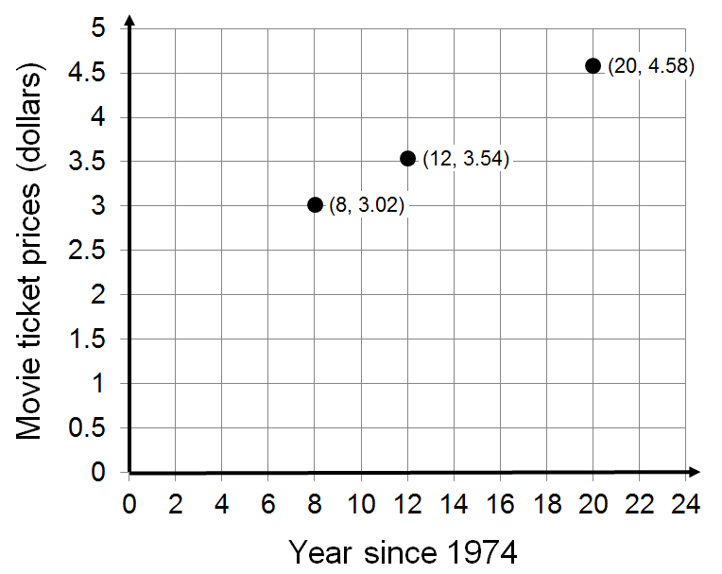
Use t for the number of years since 1974 and P for the price of a movie ticket.
Discuss the meaning of the slope and y-intercept.
Predict the price of a movie ticket 10 years after the price went to $4.
Translate P(30) to English and answer the question.
Translate, “Estimate the year the cost of a movie ticket was $6.00.” into functional notation.

Slide 29
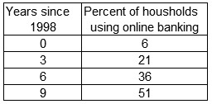
Use t for the number of years since 1998 and B for the percent of households using online banking.
Discuss the meaning of the slope and the y-intercept.
Find t if B(t) = 75 and discuss its meaning.
Translate, “When will eighty percent of households be using online banking?” into functional notation.
Predict the percent of households using online banking in 2016.

