Slide 1
Rational Numbers

Slide 2
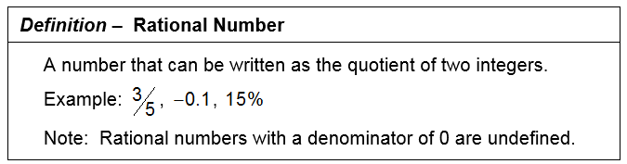


The Rational Numbers

Slide 3
Proper Fractions
Improper Fractions
and
Mixed Numbers

Slide 4
Proper Fraction
In a proper fraction the numerator (top) is less than the denominator (bottom).
The value of a proper fraction will always be between 0 (inclusive) and 1 (exclusive).

Slide 5
Improper Fraction
In an improper fraction the numerator (top) is greater than or equal to the denominator (bottom).
The value of an improper fraction is greater than or equal to 1.

Slide 6
Mixed Number
A mixed number is the sum of a positive integer and a proper fraction.

Slide 7
Writing a mixed number as an improper fraction.
The new numerator is the product of the denominator and positive integer added to the numerator. The denominator remains the same.

Slide 8
Writing an improper fraction as a mixed number.
Divide the numerator by the denominator, the quotient is the positive integer term, the difference divided by the divisor is the proper fraction term.

Slide 9
Proper Fractions
Improper Fractions
and
Mixed Numbers

Slide 10
Prime Factorization

Slide 11
Prime Number
A natural number,
greater than 1,
which has unique natural number factors 1 and itself.
Ex: 2, 3, 5, 7, 11, 13

Slide 12
Composite Number
A natural number,
greater than 1,
which is not prime.
Ex: 4, 6, 8, 9, 10

Slide 13
Prime Factorization

Slide 14
Prime Factorization
To write a natural number as the product of prime factors.
Ex: 12 = 2 x 2 x 3

Slide 15
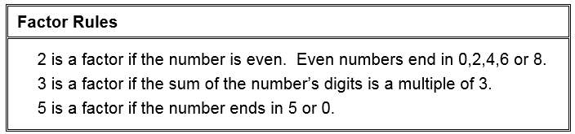
Factor Rules

Slide 16
Decide if 2, 3, and/or 5 is a factor of
42
310
987
4950

Slide 17
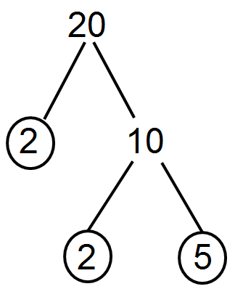
Building a factor tree for 20
20
5
4
2
2
The prime factorization of 20 is 2 x 2 x 5.

Slide 18
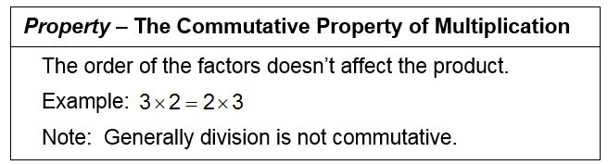

Slide 21
Find the prime factorization of 24
24
2 12
2 6
2 3
The prime factorization of 24 is 2 x 2 x 2 x 3.

Slide 22
Find the prime factorization of 315
315
5 63
3 21
7 3
The prime factorization of 315 is 3 x 3 x 5 x 7.

Slide 23
Find the prime factorization of 119
119
7 17
The prime factorization of 119 is 7 x 17.

Slide 24
Find the prime factorization of 495
495
5 99
9 11
3 3
The prime factorization of 495 is 3 x 3 x 5 x 11.

Slide 25
Find the prime factorization of 945
945
5 189
63 3
3 21
7 3
The prime factorization of 945 is 3 x 3 x 3 x 5 x 7.

Slide 26
Prime Factorization

Slide 27
Reducing Fractions

Slide 28
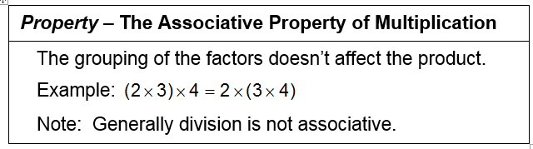
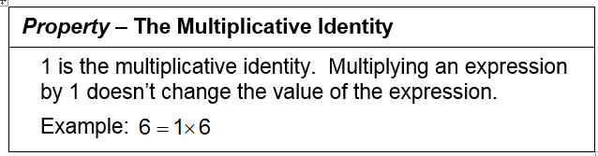

Slide 29
Reducing Fractions
A fraction is reduced when the numerator and denominator have no common factors other than 1.

Slide 30
Reducing Fractions
A fraction is reduced when the numerator and denominator have no common factors other than 1.

Slide 31
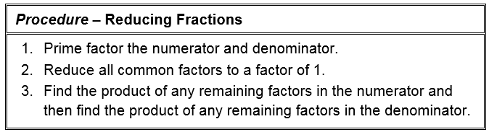

No “Gozinta” method allowed

Slide 32
No “Gozinta” (Goes into) method allowed

Slide 33
Simplify using prime factorization

Slide 34
Simplify using prime factorization

Slide 35
Simplify using prime factorization

Slide 36
Reduce using prime factorization

Slide 37
Reduce using prime factorization

Slide 38
Reduce using prime factorization

Slide 39
Reducing Fractions

Slide 40
Multiplying Fractions

Slide 41
No “Gozinta” method allowed

Slide 42
using prime factorization
Multiply
Procedure – Multiplying Fractions
1. Combine all the numerators, in prime factored form, in a single numerator.
2. Combine all the denominators, in prime factored form, in a single denominator.
3. Reduce common factors
4. Multiply the remaining factors in the numerator together and the remaining factors in the denominator together.

Slide 43
using prime factorization
Multiply

Slide 44
Procedure – Multiplying Fractions
1. Combine all the numerators, in prime factored form, in a single numerator.
2. Combine all the denominators, in prime factored form, in a single denominator.
3. Reduce common factors
4. Multiply the remaining factors in the numerator together and the remaining factors in the denominator together.

Slide 45
Multiply using prime factorization

Slide 46
Multiply using prime factorization

Slide 47
Multiply using prime factorization

Slide 48
Multiply using prime factorization

Slide 49
Multiplying Fractions

Slide 50
Dividing Fractions

Slide 51
Reciprocal
The reciprocal of a number is a second number which when multiplied to the first gives a product of 1.

Slide 52
Procedure – Dividing Fractions
To divide two fractions multiply the fraction in the numerator by the reciprocal of the fraction in the denominator.

Slide 53
Procedure – Dividing Fractions
To divide two fractions multiply the fraction in the numerator by the reciprocal of the fraction in the denominator.

Slide 54
Divide using prime factorization

Slide 55
Divide using prime factorization

Slide 56
Divide using prime factorization

Slide 57
Divide using prime factorization

Slide 58
Dividing Fractions

