Slide 1
Formulas

Slide 2
A formula is an equation that uses mathematics to express a fact or rule.
Usually the left hand side is a single letter that represents the concept we’re working with. The right hand side might include numbers, variables, operators and grouping symbols.

Slide 3
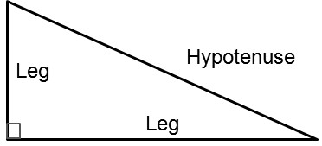
The Pythagorean Theorem
c
a
b

Slide 4
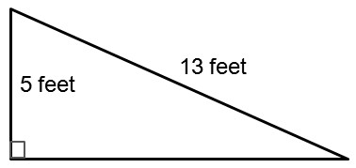
Find the length of the missing leg.
b feet
The length of the missing leg is 12 feet.

Slide 5
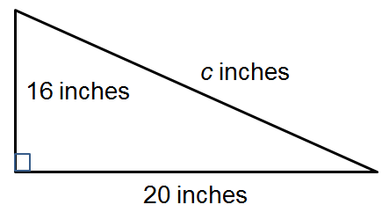
One leg of a right triangle is 4 inches shorter than the leg that is 20 inches. Find the length of the hypotenuse.
The length of the hypotenuse is about 25.6 inches.

Slide 6
The Pythagorean Theorem can help us decide if something we build is “square” (the corners are 90 degrees). You’ve built a deck that’s 12 feet by 16 feet. If the deck is square what should the diagonal distance from corner to corner through the center of the deck be?
c feet
16 feet
12 feet
The length of the diagonal should be 20 feet.

Slide 7
Temperature
Would a hot tub that’s 60º Celsius be too hot or too cold?
It would be too hot.

Slide 8
Temperature
Water freezes at 32º Fahrenheit. At what Celsius temperature does water freeze.
Water freezes at 0° Celsius.

Slide 9
Temperature
A passenger from Canada says they prefer the temperature in your car to be around 20 degrees. To accommodate their needs what Fahrenheit temperature should you use?
You should set the temperature at 68° Fahrenheit.

Slide 10
Temperature
On a trip to Europe you plan to cook a dish for your relatives and you need to set the oven to 350º Fahrenheit. What Celsius temperature should you use?
You should set the temperature of the oven to 177° C.

Slide 11
Continuous Compounding
How much should be saved today to have $50,000 in 20 years at 4% interest compounded continuously?
I would need to save at least $22,467 today.

Slide 12
Continuous Compounding
How long will it take to double $10,000 at 1% interest?
It will take about 63 years to double my money at 1%.

Slide 13
Continuous Compounding
Currently an account has $750,000. Once the account reaches $1,250,000 the account holder has decided to retire. If they would like to retire in 8 years what interest rate would they need?
The rate needs to be at least 6.4%.

Slide 14
Replace t with 40 to approximate the percent of one-person households in 2000.
Around 25.6% of households will be one person households in 2000.
Replace H with 20 to predict when the percent of one-person households first rose to 20%.
In the year 1972.
c. Replace H with 30 to predict the first year the number of one-person households will reach 30%.
c. In 2032 the number of one-person households will first reach 30%.

Slide 15
  Find their profit per house if they charge $5.00 per box.
  If they set the price at $5 per box they can expect to make about $10.35 per house.

Slide 16
Find their profit per house if they lower their price to $3.40 per box.
  If they set the price at $3.40 per box they can again expect to make about $10.35 per house.

Slide 17
The maximum profit the organization can expect per house is $10.83. Set P to 10.83 and solve for p to find the price per box that maximizes profit?
  They will earn the maximum profit per house if they set their price per box at $4.20.

Slide 18
Formulas

Slide 19
14 feet

Slide 20
14”
20”

