Slide 1
Average Rate of Change
Some Vocabulary

Slide 2
We discuss where a function is increasing, decreasing or constant using intervals on x.
The words increasing, decreasing or constant discuss the behavior of y values as x values increase (move to the right) on the number line.

Slide 3
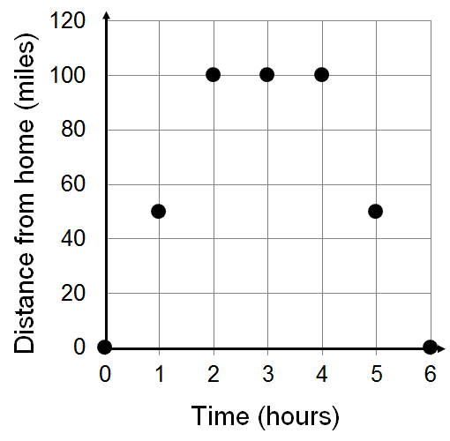
Use intervals on x to describe where the function is increasing, decreasing or constant.
Constant
Increasing
Decreasing
The function is increasing on the interval x = 0 to x = 2.
The function is constant on the interval x = 2 to x = 4.
The function is decreasing on the interval x = 4 to x = 6.

Slide 4
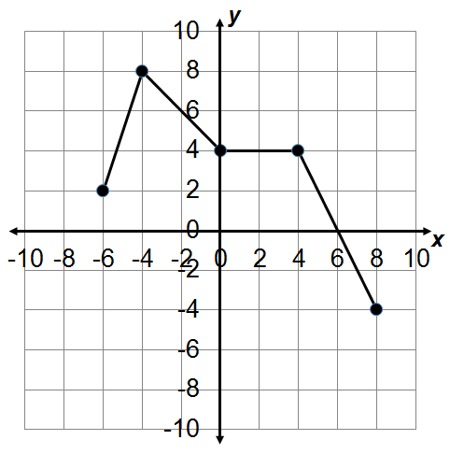
Use intervals on x to describe where the function is increasing, decreasing or constant.

Slide 5
The average rate of change begins with two ordered pairs and uses a quotient (a fraction) to compare the change (as a difference) in range values (the “y’s”) to the change in domain values (the “x’s”).
On a graph the average rate of change begins with two points and compares the change in the values of y to the change in the values of x as we go from one point to the other.

Slide 6
We describe an average rate of change as positive, negative or 0.
Zero
Positive
Negative
The average rate of change is positive from x = 0 to x = 2.
The average rate of change is 0 from x = 2 to x = 4.
The average rate of change is negative from x = 4 to x = 6.

Slide 7
Use intervals on x to describe where the average rate of change is positive, negative or 0.

Slide 8
Average Rate of Change
Some Vocabulary

Slide 9
Average Rate of Change
From a Graph

Slide 10
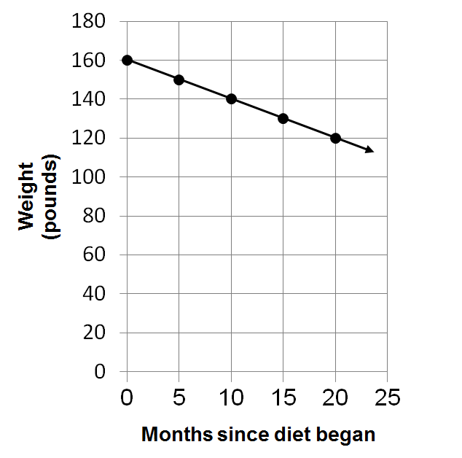
Find and describe the average rate of change as the function goes from x = 10 to x =20.
When x =10, y =140
When x =20, y =120

Slide 11
Find and describe the average rate of change as the function goes from x = 10 to x =20.
When x =10, y =140
When x =20, y =120
The decreasing function has a negative average rate of change.

Slide 12
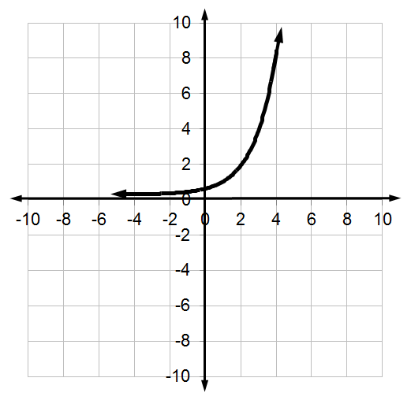
Find, and describe the average rate of change as the function goes from x = 2 to x = 4.
When x =2, y =2
When x =4, y =8
Average rate of change
The increasing function has a positive average rate of change.

Slide 13
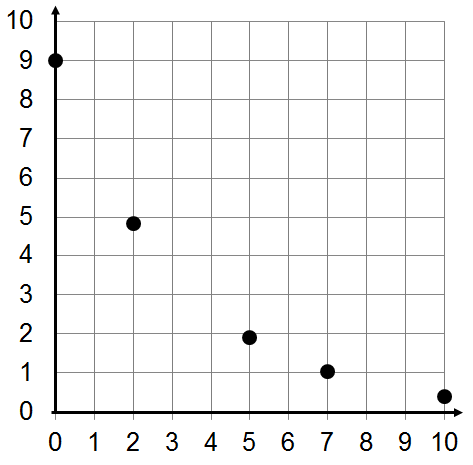
Find, and describe, the average rate of change as the function goes from x = 0 to x =7.
When x =0, y =9
When x =7, y =1
Average rate of change
The decreasing function has a negative average rate of change.

Slide 14
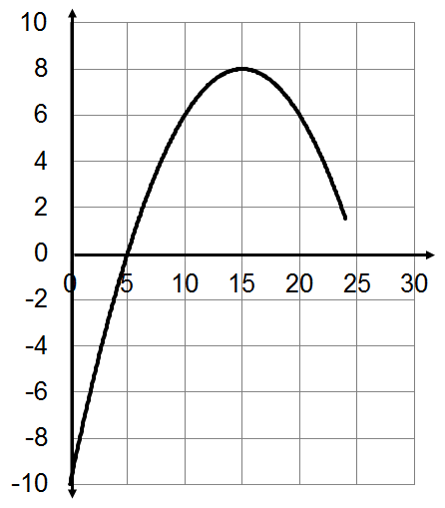
Find, and describe, the average rate of change as the function goes from x = 10 to x =20.
When x =10, y =6
When x =20, y =6
Average rate of change
The constant function has an average rate of change of 0.

Slide 15
Average Rate of Change
From a Graph

Slide 16
Applying Average Rate of Change
To a Graph – Getting Ready

Slide 17
Applying the Average Rate of Change
When applying the average rate of change make sure to include the units (units are what the numbers are counting or measuring) along with the final values.
We usually divide to get a denominator of 1.

Slide 18
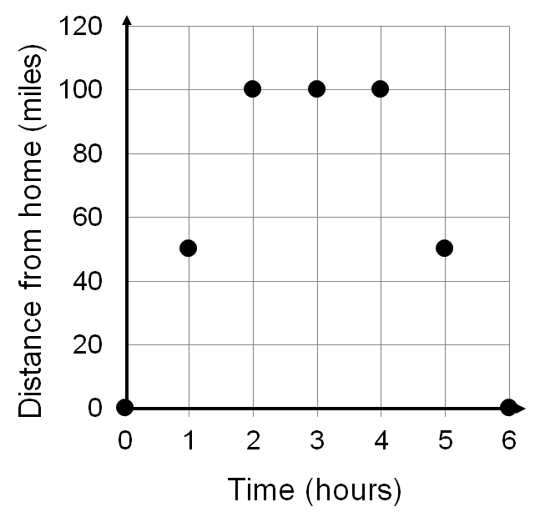
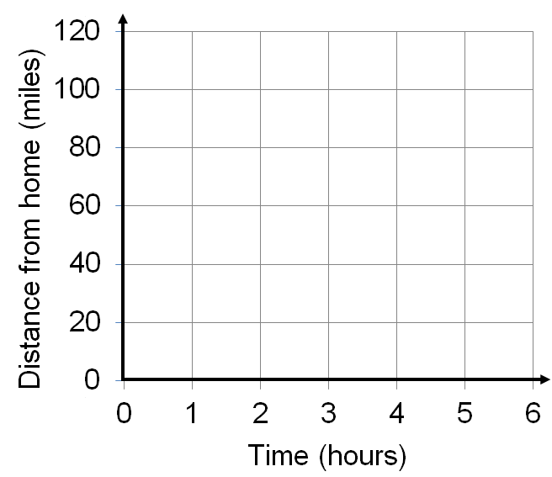
What’s the general meaning for the average rate of change?
How the distance from home changes over time.
What’s the specific meaning for the average rate of change for the interval x = 0 to x =2.
(2,100)
For the first two hours the distance from home was increasing on average by fifty miles per hour.
(0,0)

Slide 19
What’s the specific meaning for the average rate of change for the interval x = 2 to x =4?
From 2 hours to 4 hours the distance from home remained constant at 100 miles.

Slide 20
What’s the specific meaning for the average rate of change for the interval x =4 to x =6?
For the last two hours the distance from home was decreasing on average by fifty miles every hour.

Slide 21
Applying Average Rate of Change
To a Graph – Getting Ready

Slide 22
Applying Average Rate of Change
To a Graph

Slide 23
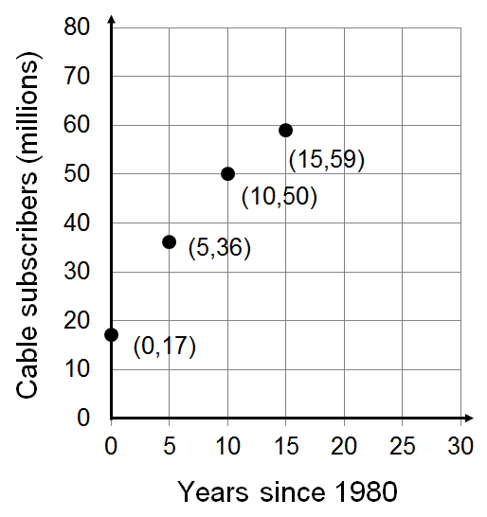
What’s the specific meaning of the average rate of change between 1980 and 1985?
What’s the general meaning of the average rate of change?
The change in the number of subscribers over time.
Between 1980 and 1985 the number of subscribers on average was increasing by 3.8 million per year.
What’s the specific meaning of the average rate of change between 1990 and 1995?
Between 1990 and 1995 the number of subscribers on average was increasing by 1.8 million per year.
Describe the trend in the average rate of change for the two time periods.
Although the number of subscribers is continuing to increase the rate of increase is slowing down.

Slide 24
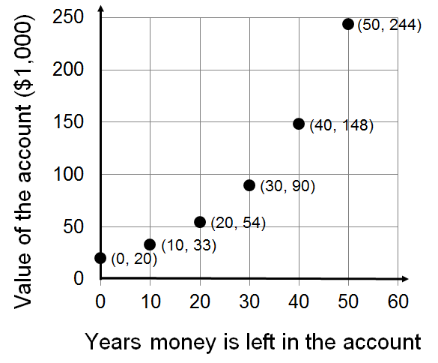
What’s the general meaning of the average rate of change?
What’s the specific meaning for the average rate of change over the first ten years (from year 0 to year 10)?
The change in the value of the account over time.
On average for the first 10 years the value of the account is increasing by $1,300 per year.
What’s the specific meaning for the average rate of change between years 40 and 50.
On average between years 40 and 50 the value of the account is increasing by $9,600 per year.
Describe the trend in the average rate of change for the two time periods.
The longer you leave your money in the account the faster the rate of increase in the value of the account.

Slide 25
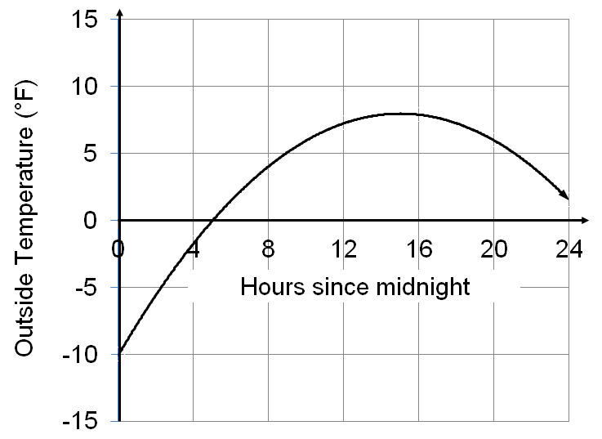
What’s the general meaning of the average rate of change?
The change in the outside temperature over time.
What’s the specific meaning for the average rate of change between midnight and 4 a.m.?
What’s the specific meaning for the average rate of change between 4 p.m. and 8 p.m.?
On average the temperature is increasing 2 degrees per hour between midnight and 4 a.m..
On average the temperature is decreasing half a degree per hour between 4 p.m. and 8 p.m..

Slide 26
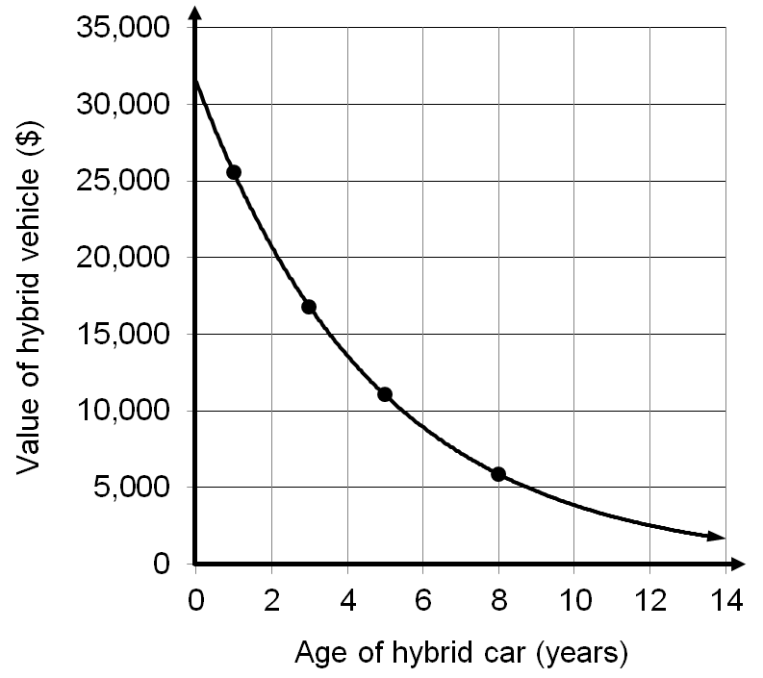
Estimate the specific meaning of the average rate of change between purchase and the beginning of year 2.
What’s the general meaning of the average rate of change?
The change in the value of a hybrid vehicle over time.
Between purchase and the beginning of year 2 the value is decreasing on average by $6,000 per year.
Estimate the specific meaning of the average rate of change between year 8 and year 10.
Between years 8 and 10 the value of the vehicle is decreasing on average by $1,000 per year.
Describe the trend in the average rate of change for the two time periods.
Although the value of the vehicle is steadily decreasing over time the rate at which it’s decreasing is slowing down.

Slide 27
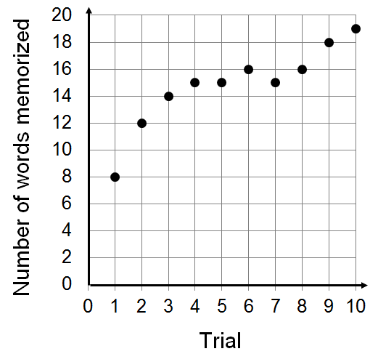
What’s the general meaning of the average rate of change?
Discuss the specific meaning of the average rate of change between trial 1 and 2.
Discuss the specific meaning of the average rate of change between trial 1 and 5.
Discuss the specific meaning of the average rate of change between trial 4 and 5.
Discuss the specific meaning of the average rate of change between trial 6 and 7.
Discuss the specific meaning of the average rate of change between trial 6 and 8.
Discuss the specific meaning of the average rate of change between trial 1 and 10.
recalled

Slide 28
What’s the general meaning of the slope?
How the distance from home changes over time.
What’s the specific meaning of the slope for the interval x = 0 to x =2.
For the first two hours they were, on average, traveling away from home at fifty miles per hour.

Slide 29
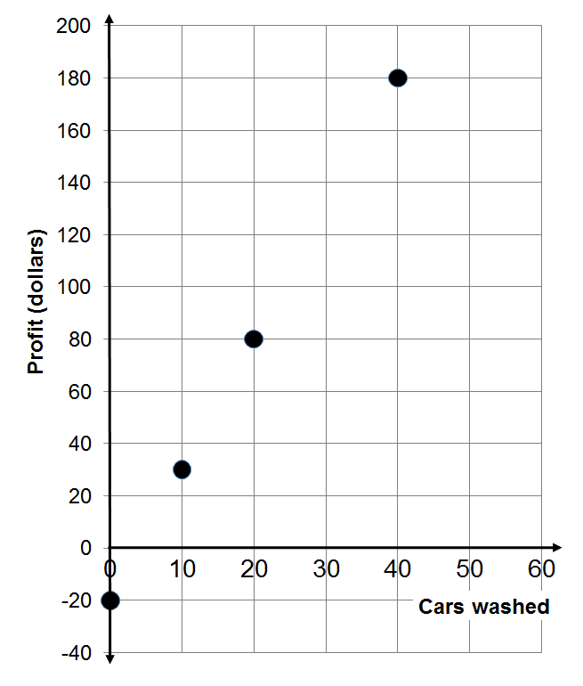
Discuss the general meaning of the slope.
How profit changes as the number of cars washed changes.
Discuss the specific meaning of the slope.
Profit increases $5 for every car that’s washed.

Slide 30
Applying Average Rate of Change
To a Graph

Slide 31
Applying Average Rate of Change
To a Data Table

Slide 32
Find, and discuss the meaning of, the average rate of change for the first 10 months.
What’s the general meaning of the average rate of change?
Find, and discuss the meaning of, the average rate of change for month 10 to month 15.
How the outstanding debt is changing over time.
On average the loan amount is decreasing by $320 per month.
Find, and discuss the meaning of, the average rate of change for month 0 to month 15.
On average the loan amount is decreasing by $320 per month.
Describe the trend in the average rate of change.
Over time the average rate of change remains constantly decreasing at $320 per month.
On average the loan amount is decreasing by $320 per month.

Slide 33
Discuss the general meaning of the slope.
Months since diet began | Weight in pounds
0 | 180
5 | 170
15 | 150
25 | 130
How the persons weight changes over time.
Discuss the specific meaning of the slope.
Their weight decreases two pounds per month.

Slide 34
Months since diet began | Weight in pounds
0 | 180
5 | 170
15 | 150
25 | 130
Find the slope.

Slide 35
Find the slope

Slide 36
Discuss the general meaning of the slope.
How the number of cars in the ramp changes over time.
Discuss the specific meaning of the slope.
The number of cars in the lot is increasing by 24 cars per minute.

Slide 37
What’s the specific meaning of the slope?
What’s the general meaning of the slope?
How the outstanding loan amount is changing over time.
The amount left on the loan is dropping by $250 a month.

