Slide 1
Integer operations using sets of units

Slide 2
Using sets of units
3
1
1
1
-3
-1
-1
-1

Slide 3
Addition combines sets of units
Using sets of units find
3
2
5
1
1
1
1
1
1
1
1
1
1

Slide 4
Using sets of units find
-3
-2
-5
-1
-1
-1
-1
-1
-1
-1
-1
-1
-1

Slide 5
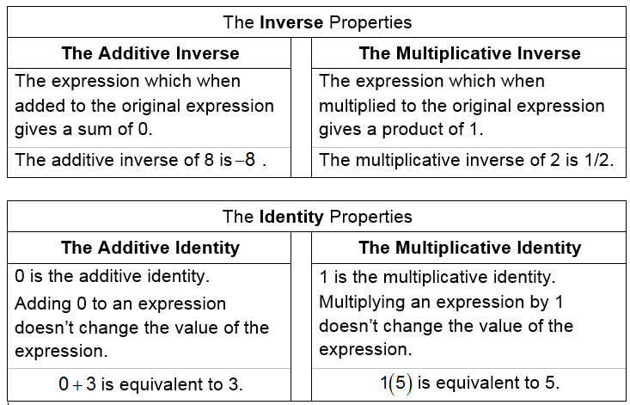
Using sets of units find
-3
2
-1
-1
1
-1
-1
0
-1
-1
1
-1
1
0
1

Slide 6
Using sets of units find
3
-2
1
1
-1
1
1
0
1
1
-1
1
-1
0
-1

Slide 7
Using sets of units find
2
-5
-3
-1
1
1
1
-1
1
-1
-1
-1
0
0
-1
-1
-1
-1
-1

Slide 8
Using sets of units find
-2
5
3
1
1
1
1
-1
-1
0
-1
-1
1
1
0
1
1
1
1

Slide 9
Subtraction removes units from a set
Using a set of units find
1
1
1

Slide 10
Using a set of units find
-1
-1
-1

Slide 11
Using a set of units find
3
1
1
1
0
0
-1
1
-1
1

Slide 12
Using a set of units find
-3
-1
-1
-1
0
0
-1
1
-1
1

Slide 13
Using a set of units find

Slide 14
Using sets of units find

Slide 15
Integer operations using sets of units

